Slide 1
2015 AFSA Tax Clinic
Oregon Sand Dunes
Eric Fong, MAcc

Slide 2
Important Note
Macs (and Linux) – Not supported
Very few companies develop tax software for Macs (no supply)
Virtually no tax preparers use Macs (no demand)
Software
Ufile is generally used by consumers
Taxprep / CANTAX used by professionals
Not a replacement for AFM202
Notes:
Tax Software on Macs – an issue that sounds like it came out of ECON101
No supply
No demand
Ufile is generally used by consumers, and provides an easy step-by-step wizard that makes it easy for people to prepare tax returns.
Taxprep is software used by professional accounting firms (among others) and is much less user-friendly. Experienced people however, can prepare forms quickly and navigate to whatever forms very quickly. Pages resemble the tax forms, which makes it easy for experienced people but hard for new people.
MACS:
If you’ve added Bootcamp or Parallels just for Tax Clinic, I suggest you keep it installed because you will be given an educational copy of CCH Personal Taxprep in AFM202. Obviously, this will be Windows-only. Your classes, exams and assignments will be all about using Taxprep and while it is available in computer labs and you’re allowed to partner for assignments, you’re missing out on a lot.
Also, take AFM202. Professor Alan MacNaughton is very knowledgeable and an excellent teacher.
He’s been at Waterloo since 1985 and used to serve as the Director of Personal Income Taxation for the federal Department of Finance in Ottawa – the person who writes legislation that goes into the Income Tax Act.

Slide 3
More Important Things
Protect your hardware!
Spyware, keyloggers, etc.
Firewall: GlassWire, Anti-virus: Microsoft Security Essentials
Dress well
No torn jeans, offensive logos/words/etc.
Representing AFSA, UW and Yourself
Media
Unlikely
Don’t talk to them
Notes:
You are in charge of protecting clients’ very sensitive financial information, including their SIN.
If your system is compromised, you’re giving away the client’s name, address, SIN, income and all sorts of personal information.
Liability issue. Let us know. We will tell CRA, who will handle it from then on.

Slide 4
EFILE Registration
We told you to do this a while ago!
MAKE SURE YOU SAVED THIS INFO:
http://tinyurl.com/afsatax
Notes:
You are in charge of protecting clients’ very sensitive financial information, including their SIN.
If your system is compromised, you’re giving away the client’s name, address, SIN, income and all sorts of personal information.
Liability issue. Let us know. We will tell CRA, who will handle it from then on.

Slide 5
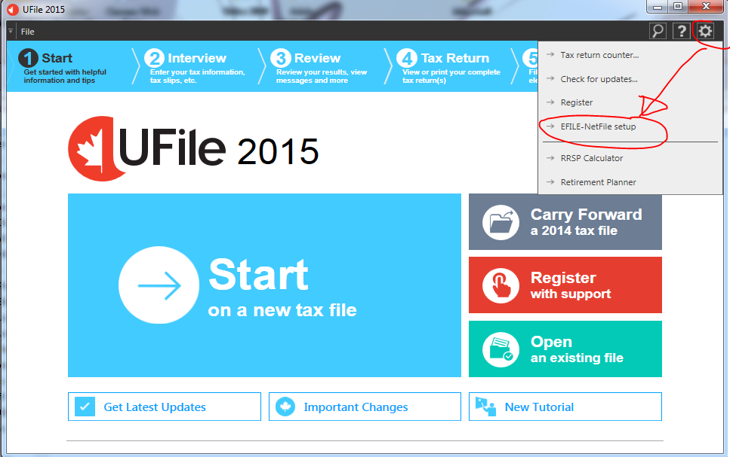

Slide 6
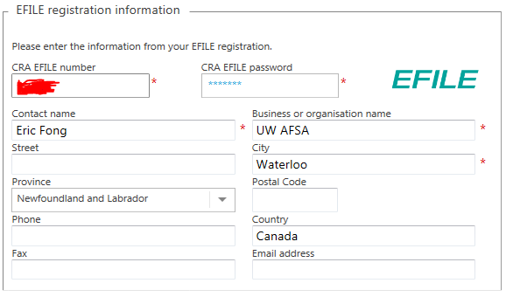

Slide 7
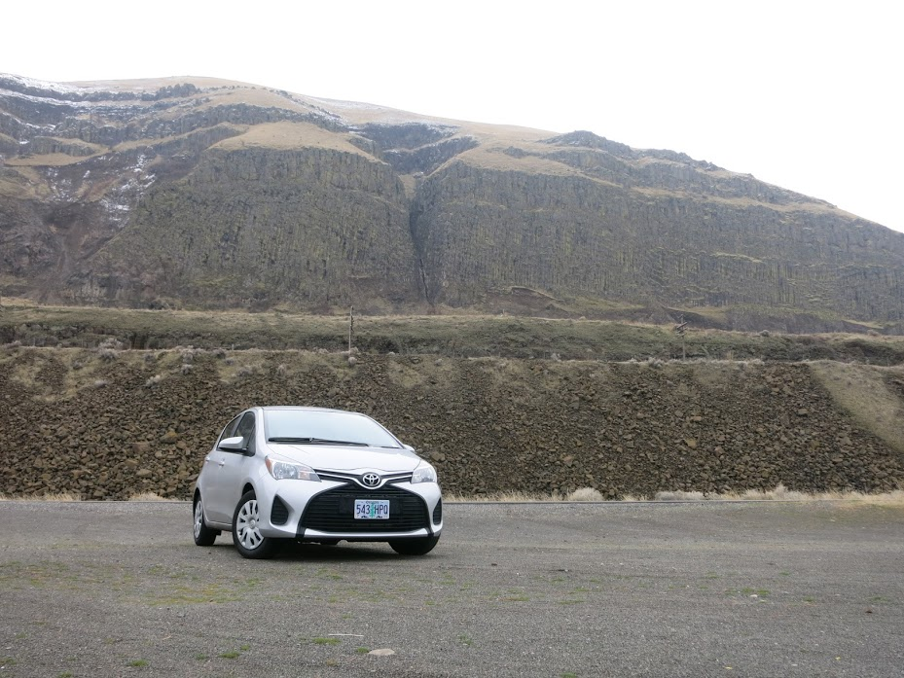
Taxes are Easy
Columbia Gorge, OR
Notes:
This is all the important background information you need to know in order to look competent. You know, so when you talk to your parents, co-workers, non-tax friends and interviewers, they think you know tax.
It’s easy stuff.

Slide 8
Everything you need to know
Canada Revenue Agency (CRA) administers Income Tax
Why should you file?
How to send your return to CRA
EFILE
NETFILE
Paper File
How to pay

Slide 9
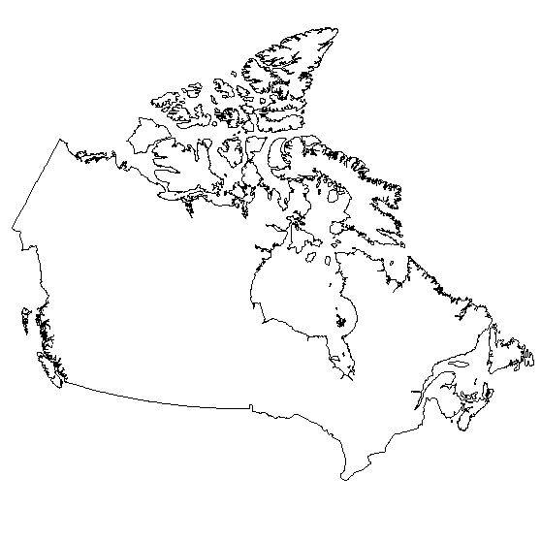
Who Receives Income Taxes?
Federal
Provincial

Slide 10
How Are Income Taxes Collected?
Canada Revenue Agency (CRA)
Administers federal tax law, and for most provinces as well
One tax return for both federal/provincial
Pay only to CRA
EXCEPTION: Québec
Out of scope
We’re the exception!
Notes:
Once upon a time, each province had a separate tax return that had to be submitted separately. Ontario only switched to an all-CRA method as late as 2008.

Slide 11
Differences between Provinces
Tax Rates – automatically calculated
Credits
We will be looking only at Ontario credits
Filing methods
We’re the exception!

Slide 12
Filing a Tax Return
Annual
Due April 30
Multiple ways of filing:
NETFILE (taxpayer does own return, files online)
EFILE (3rd party prepares and files return)
Paper File (mail return to CRA)

Slide 13
Preparing Tax Returns
We will use a program called UFILE
UFILE (noun) – a program to prepare returns
EFILE (verb) – the method through which CRA accepts tax returns from 3rd-party preparers
We will use Ufile to EFILE.
We will use Ufile to prepare paper returns
Notes:
It’s important to get this straight, because a lot of people may easily get this mixed up between NETFILE, Ufile and eFile. If you can’t use ‘eFile’ correctly in a sentence, this is something employers will catch on to!

Slide 14
EFILE
Prepare return
EFILE return
Sends all necessary information to CRA
Taxpayer doesn’t have to mail anything in, but MUST keep all records for 6 years
Give PDF copy of return via USB/email
Return processed faster (eg. refunds!)
Not everyone is eligible
Notes:
We will be using EFILE whenever we can

Slide 15
When can’t you EFILE!?
When UFILE says so
PPT slide deck contains the list (hidden)
No SIN OR international address

Slide 16
Who can’t EFILE!?
The taxpayer is a deemed resident (not subject to provincial or territorial tax).
The taxpayer died prior to the current tax year. Early filed and Elective deceased returns also remain as exclusions.
The taxpayer's social insurance number begins with 0.
The taxpayer is coded bankrupt according to Canada Revenue Agency's records and is filing an in-bankruptcy or post-bankruptcy return. Only pre-bankruptcy returns are accepted through EFILE.
Notes:
http://www.efile.cra.gc.ca/l-xclsns-eng.html
The first one you’ll learn a lot more about in AFM362 / 363. Tax residency is a very broad and grey area about who should be taxed as a ‘Canadian resident. This is NOT the same as being a Canadian citizen or permanent residency. It is possible for an international student to be a ‘Canadian resident for tax purposes’ (aka deemed resident), how to determine this is far outside the scope of this training session.
Also, not concerned because for our purposes, deemed residents will be excluded for other reasons
Not allowed to prepare deceased returns. If someone says ‘I am dead’, tell them ‘sorry I can’t help you’.
Taxpayer’s SIN starts with 0 -> Wikipedia says “CRA may assign fictitious SIN numbers beginning with zero to taxpayers who do not have SINs” – this would be an ITN for people who aren’t eligible for SIN but need to file their tax returns. ← We’ve actually found that sometimes you can still EFILE, so just try EFILE and then tell them to paper return if it doesn’t work.
We aren’t doing returns for people who file for bankruptcy

Slide 17
Who else can’t EFILE!?
The taxpayer is an emigrant or a non-resident. The taxpayer's address is outside Canada. The taxpayer is subject to provincial/territorial income tax in more than one jurisdiction.
Notes:
First two will catch virtually all of the people we have to file paper returns for. International students.
Last one may catch co-op students who worked in more than one province in 2013! You will see how to find this later.

Slide 18
Who else can’t EFILE!?
Rest I won’t look at except:
The taxpayer is claiming:
[…]
a disability amount for themself or for their spouse or common-law partner and there is no Form T2201, Disability Tax Credit Certificate, on record, or a new Form T2201 is required
a disability amount for a dependant other than their spouse or common-law partner and there is a first time claim, or a new Form T2201 is required, or the claim is for more than 10 dependants
Notes:
Someone who is newly disabled can’t EFILE.

Slide 19
Paper File (not a fancy name)
Prepare return
Give PDF copy of return via USB/email
Taxpayer prints at home
Taxpayer must attach required slips and receipts and either mail the return or drop it off
There is a page in the PDF that says what pages to mail, and what order to put them in
Notes:
Paper File is not the name of the method, it’s just what we will call it to contrast it against EFILE.
Has no name, since it used to be the only way of filing your tax return.. so it was called ‘filing’.

Slide 20
Addresses
Mail:
Depends on mailing address
Really doesn’t matter….
Waterloo residents:
Summerside Tax Centre 275 Pope Road Summerside PE C1N 6A2
Drop off:
166 Frederick Street Kitchener ON N2H 0A9
(near Frederick / Weber)
Notes:
If the mailing address is Toronto, the relevant mailing address is:
Canada Revenue Agency Tax Centre 1050 Notre Dame Avenue Sudbury ON P3A 5C2

Slide 21
Payment
Rare, for our clients
Both methods (EFILE/Paper):
Pay online via their bank
Pay at a teller at their bank
Cheque
Make out to ‘Receiver General’
Write SIN on back of cheque
Write 201 Income Tax in Memo

Slide 22
Quiztime!
A) EFILE
B) NETFILE
C) Paper File

Slide 23
Tax Theory

Slide 24
Slide One
Taxes Paid
Less: Taxes Already Paid
= Tax Owing (Refund)
Taxes Paid – Taxes Already Paid = Owing
Notes:
A tax return is a reconciliation of the taxes you paid and the actual taxes you are owing.
The taxes you pay throughout the year are only a guesstimate – your employer withholds tax but does not know what tax rate you’re acutally at because you likely have other sources of income (investments, etc.)
The tax return adds up ALL your income from the different sources and calculates the amount of tax you owe. Then it calculates how much

Slide 25
Slide Two
Income
Less: Deductions
Equals: Taxable Income
Calculate Taxes
Less: Tax Credits
Taxes

Slide 26
Major Steps
Calculate Total Income
Deductions
Calculate Taxable Income
Calculate Tax Payable
Subtract Credits
Subtract Income Tax Deducted at Source
Refund / Payable

Slide 27
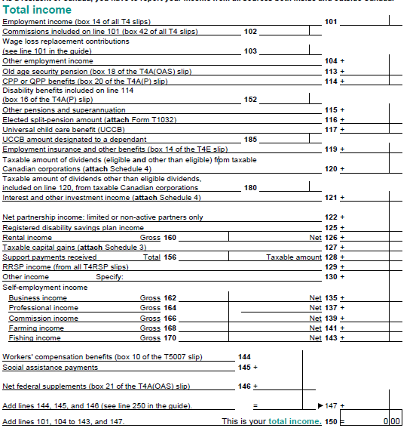
Total Income
Page 2 of Jacket
Self-explanatory

Slide 28
Deductions
Government allows specific deductions to your total income
Represents using your income which reduce your ability to pay
Used to encourage certain behaviours

Slide 29
Common Examples
RRSP Contributions
Union Dues
Professional Dues
Child Care
Moving Expenses
Notes:
Union Dues – if you belong to the Canadian Auto Workers
Professional Dues – if you pay fees toward a professional organization (eg. CPAO)

Slide 30
Taxable Income
Total Income – Deductions = Net Income
Net Income – More Deductions = Taxable Income
We’re not concerned about Net Income vs Taxable Income
Will be the same for all the returns we prepare
Notes:
This slide for information purposes only.

Slide 31
Taxes Payable
See ‘Schedule 1’ link
‘Tax Brackets’ affect how much tax you pay
Progressive
Notes:
Tax Brackets are Progressive, the first $xx,xxx earned is taxed at a low rate, the next $xx,xxx is taxed at a higher rate, so on
Note that the Schedule 1 Link is only for FEDERAL tax. Provinces still have their own rates which are added on top.

Slide 32
Credits
(Generally) reduces tax payable
Also used to encourage certain behaviour
Refundable vs. Non-Refundable
Some don’t affect the balance of return (ie. paid separately!)
If you receive $1 of credit, it reduces your taxes payable by 15 cents (federal tax)
Notes:
Even if someone doesn’t have any income, it is still worth it to file an income tax return to get some of the refundable tax credits! They can only be obtained by filing a tax return.

Slide 33
Source Deductions
Employer sends part of your paycheque to the government
Covers CPP, EI and Income Tax
More tax deducted at source than necesary
Notes:
Usually higher than necessary to encourage people to file their returns to get a refund

Slide 34
Refund / Balance Owing
Represents how much they have to pay now, or will get back after the CRA processes return
The only line that your client will probably care about
Tax Return is simply a reconciliation
Notes:
As mentioned before, it should be very rare for any of our clients to have a tax payable, because the government purposely makes sure that employers withhold more money from your paycheque than is necessary

Slide 35
Common Misconceptions
Tax Refund / Balance Owing vs Taxes Payable (tinyurl.com/allthosedocs)
“For years, I used to go to a fancy accountant to get my taxes done. It cost me around $750, and I always wound up owing at least $1,000 in the end.”
“[a ‘tax preparer’] charged me $350 and I got a $350 refund, so I was even.”
“Filing my taxes through TurboTax would cost $130 (I live in one state and work in another, so I have two state returns), so my refund had to be greater than $130 for me to go with TurboTax. As it turned out, TurboTax calculated that I should net more than $2,000 in refunds”
Notes:
How to tell if someone knows anything at all about tax.

Slide 36
Common Misconceptions
Tax Refund / Balance Owing vs Taxes Payable
For our tax planning purposes, we are NOT AT ALL concerned about Refund / Balance Owing
Notes:
Unfortunate if they owe tax after all the source deductions. Not our fault. If they have a refund, that doesn’t mean that they can’t get a bigger refund. Concentrate on TAXES PAYABLE.

Slide 37
Common Misconceptions Pt2
Deductions vs Credit
Deductions decrease Income
(Income is used to calculate taxes payable)
Credit decreases Taxes Payable

Slide 38
Common Misconceptions Pt3
Tax Preparation vs Tax Planning
Notes:
If you’re ever considering a career in tax, don’t forget this is just the basics.
Tax preparation is mostly data entry, mixed with interpersonal skills. It is backwards-looking.
Tax planning requires a thorough understanding of the tax system and proposed budget changes because you’re building a strategy. It’s forward-looking.

Slide 39
Unboxing UFILE
Unboxing a BlackBerry Q5
Notes:
This is all the important background information you need to know in order to look competent. You know, so when you talk to your parents, co-workers, non-tax friends and interviewers, they think you know tax.
It’s easy stuff.

Slide 40
Before you Start
Absolutely super most important-est things:
TUITION (Did you bring your tuition slip?)
RENT (Did you pay rent or live in residence?)
INCOME (Did you make money this year?)
Please ask if any of these three things are missing!

Slide 41
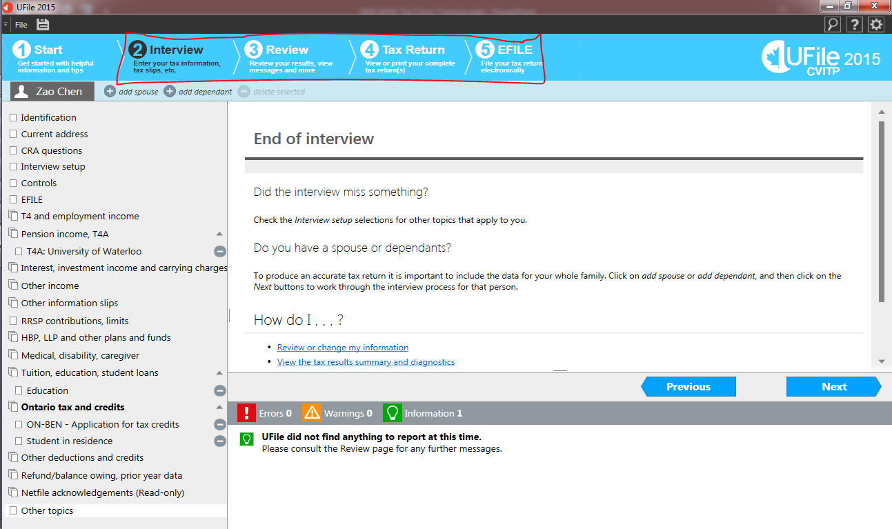
Main Steps
Notes:
2) Interview section is where you enter all the information for the tax return
3) Is a summary results page
4) Is the Tax Return forms (prefaced by special Ufile summary pages)
5) Go here to EFILE (please don’t try it on any of our cases)

Slide 42
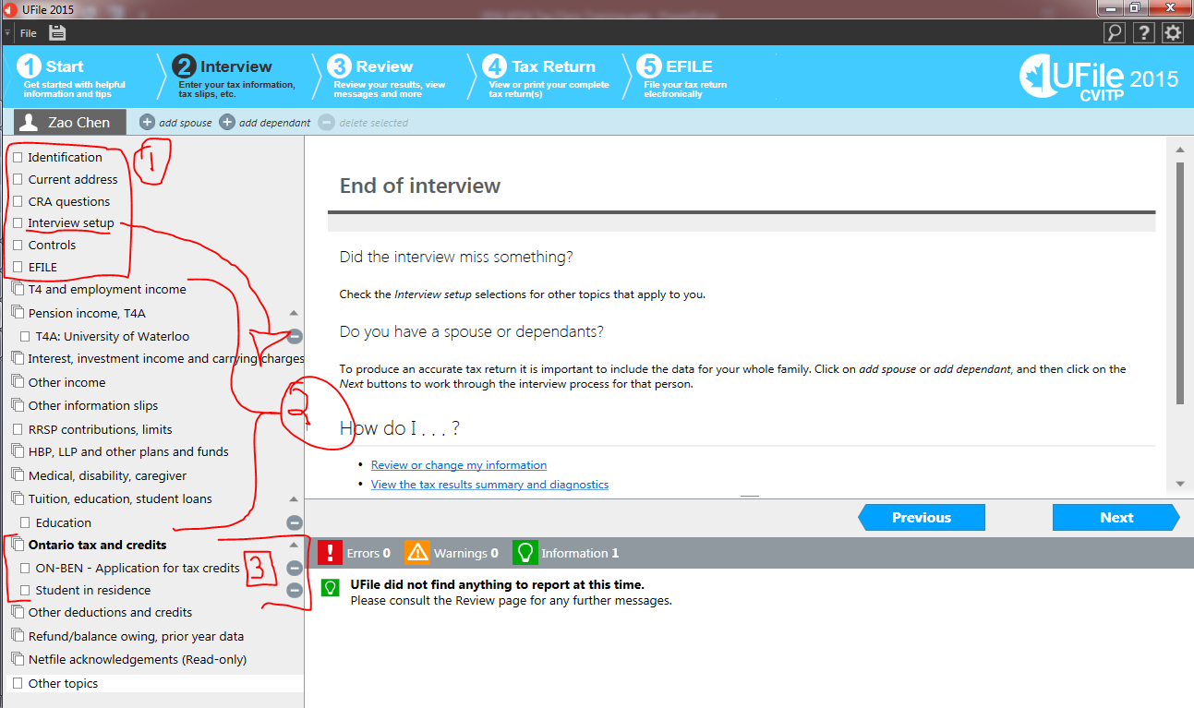
Notes:
These are the general steps of the Interview Section
Fill in the client’s personal information Interview setup is where you select what forms the client has – which then generates the list on Option 2
Enter information from each individual slip (if you have more than 1 of an item, you can add an additional slip (Eg. 2 T4A’s).
Enter any rent information / student residence information here. You MUST make sure that “Application for tax credits” is selected.

Slide 43
Super Easy Example
Name: Zao Chen
Address: See T2202A (Below)
Birthdate: August 13, 1996
SIN: 333-333-334
First time filing
Tuition: See next slide for T2202A
No transfer to parents
Rent: Lived in V1 for 4 months
Income: Scholarship only (T4A next slides)
Notes:
“Step 2 refers to the tabs in the Ufile Program”. I am not miserably failing at numbering slides.

Slide 44
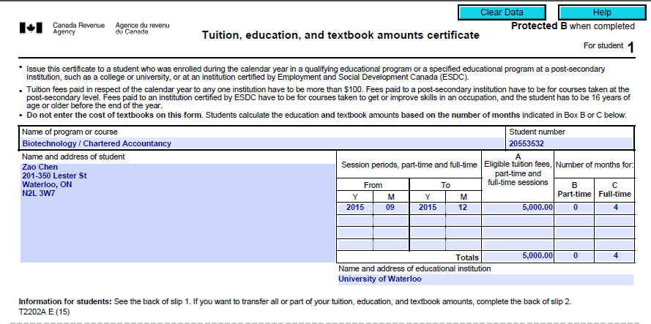

Slide 45
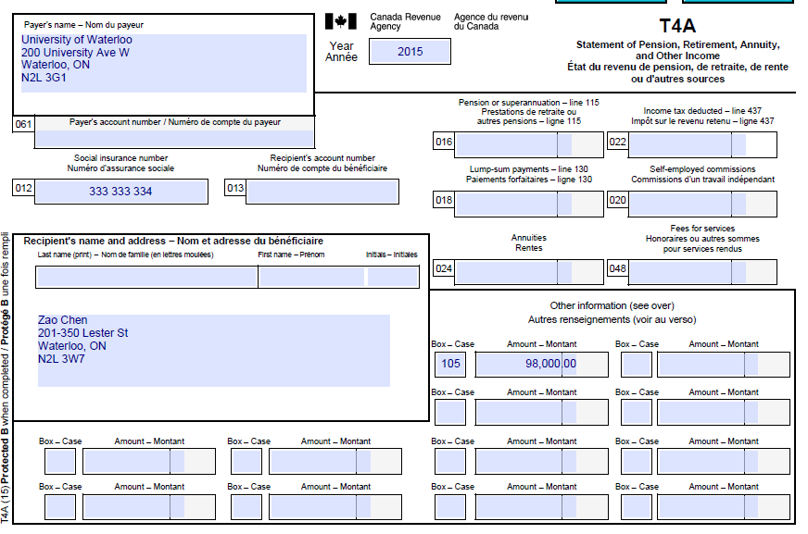

Slide 46
What is your Balance Owing?
$24,646
$0

Slide 47
What is the GST Credit?
$276
$0

Slide 48
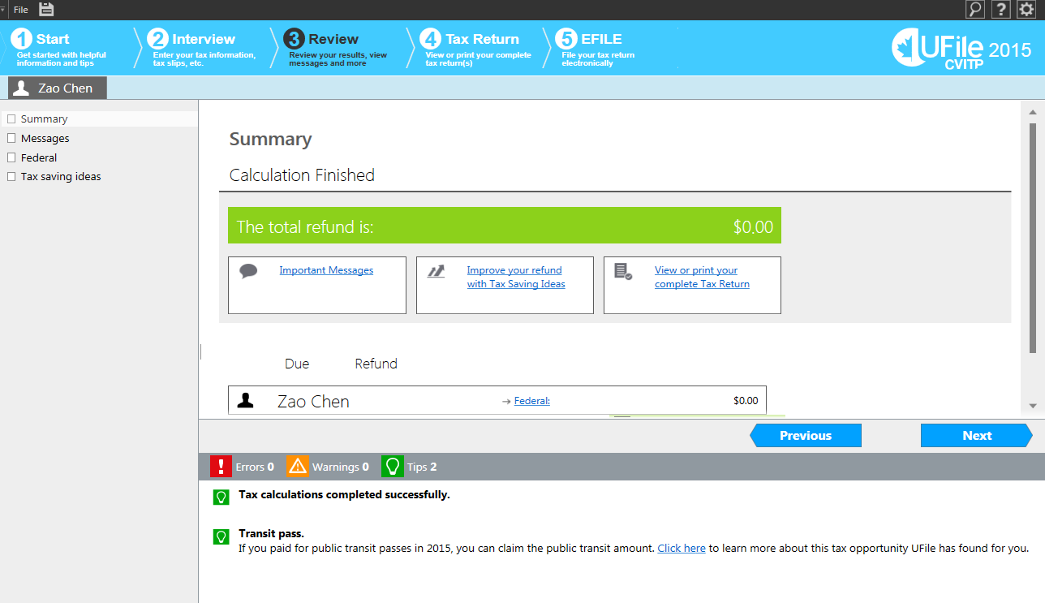
Hey Zao! You get no refund! :D

Slide 49
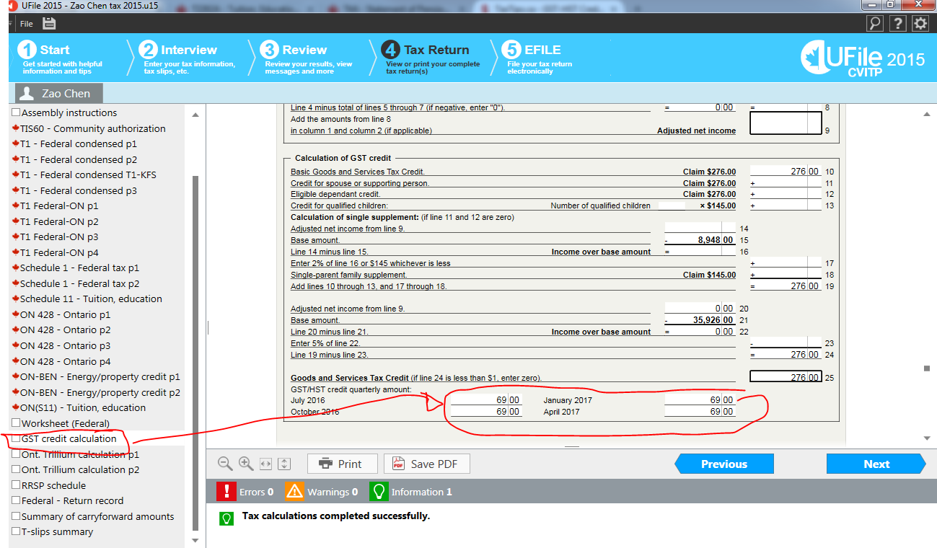
Hey Zao! You will get a GST credit of $69 on each of these four dates for being poor!

Slide 50
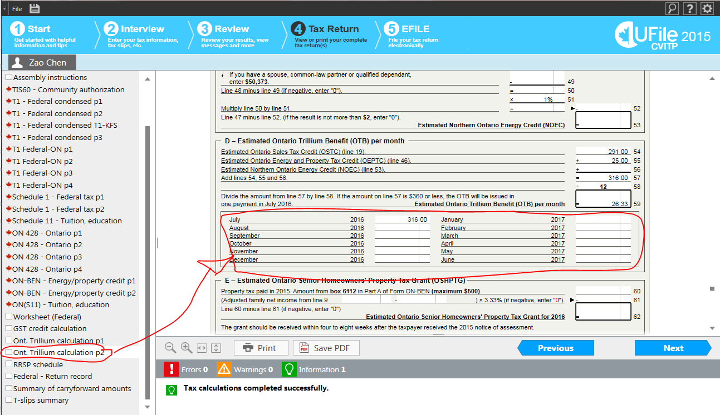
Hey Zao! You will get $316 from Ontario for being poor and living in residence!

Slide 51
Post – Return
Hey Zao! I’ve created a text file with your refunds:
$0 refund from filing your tax return
$69 over four quarters for the GST Credit
$316 as a lump sum for Ontario Trillium Benefit (includes Ontario Sales Tax and a credit for renting/living in student residence!)
I’ve also saved a copy of the tax return on your USB as a PDF
I’ve also saved the UFile file on your USB in case you want us to make changes in the future! The password is _________________

Slide 52
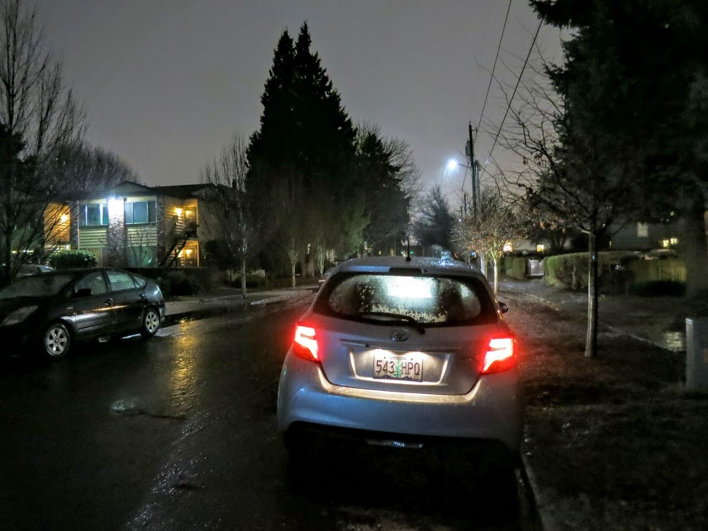
In-Depth Interview
Portland, OR
Notes:
This is all the important background information you need to know in order to look competent. You know, so when you talk to your parents, co-workers, non-tax friends and interviewers, they think you know tax.
It’s easy stuff.

Slide 53
Step 2: Interview - Identification
Identification
Fill in all personal information
SIN can be found on either the ‘Notice of Assessment’, any income slips (eg. T4), last year’s tax return, etc.
If program says SIN is invalid, check again (the program’s right!)
No SIN? Enter 333-333-334 and ask them to use white-out / correction fluid after they print (see other topics for more about International Students)
Notes:
“Step 2 refers to the tabs in the Ufile Program”. I am not miserably failing at numbering slides.
If the program says that a SIN is invalid, UFILE is always right, because there is an algorithm to determine if a SIN is valid or not
(for the curious see the Luhn Algorithm here: https://en.wikipedia.org/wiki/Social_Insurance_Number )

Slide 54
Step 2: Interview - Identification
Province of Residence
Think of this as ‘where did you have a place to stay on Dec 31, 2015’
Generally Ontario

Slide 55
Step 2: Interview - Identification
Marital Status
Single
Common-Law
Married
Widowed
Divorced
Separated
Notes:
Common-law – if it looks like a marriage, then CRA will deem you to be common-law, which receives much of the same benefits/drawbacks as being married
AT LEAST ONE:
1.) has been living with you in a conjugal relationship, and this current relationship has lasted at least 12 continuous months; Note: In this definition, 12 continuous months includes any period you were separated for less than 90 days because of a breakdown in the relationship.
2.) is the parent of your child by birth or adoption; or
3.) has custody and control of your child (or had custody and control immediately before the child turned 19 years of age) and your child is wholly dependent on that person for support.

Slide 56
Step 2: Interview – CRA Questions
Are you filing an income tax return for the first time?
Online Notice of Assessment? ***NEW***
Always Choose NO! (or leave blank)
Notes:
http://www.cra-arc.gc.ca/tx/ndvdls/tpcs/ncm-tx/mngnlnml-eng.html
PLEAES CHOOSE NO
If you choose Yes: INSTEAD of mailing you a paper copy, they will send you a notification to view your notice of assessment on the CRA MyAccount website.
It can take days to set up MyAccount.

Slide 57
Step 2: Interview – CRA Questions
Do you own foreign property over $100,000? (required)
Should be no
Make sure you ask this! Major penalties!
Measurement:
Cost (not FMV) > $100,000
Investment property ONLY such as shares, rental property, etc.
Not personal-use cottage/house
Some internationals may own a home in a foreign country!

Slide 58
Step 2: Interview – CRA Questions
As a Canadian Citizen, do you authorize the CRA to […]
Allows Election Canada to update their voters list
Students can still vote in whatever jurisdiction they reside in, just need to show up at polling station with proof of residence
Therefore, not a big issue yes or no.

Slide 59
Step 2: Interview – CRA Questions
Tick if this return is being prepared by the community volunteer.
Don’t uncheck it!

Slide 60
Step 2: Interview – Interview Setup
Sets up all the future screens you will look through later to enter information
Will talk about later!

Slide 61
Interview Setup - Income
I had no income from any source
Won’t let you calculate the tax return if you don’t check a box in that list, so choose this one if no income
“No income” actually means taxable income. Since scholarships are not taxable, you must check “No income” even if there is scholarship income! Otherwise the program doesn’t work
Yes, UFile is weird like that.

Slide 62
Step 2: Interview – Current Address
Mailing Address
Suggest using parents’ address
CRA WILL mail private information to the chosen address
Can’t be changed using EFILE
International addresses – no problem!
The field that says “Province” only allows 2 provinces. Put foreign states/provinces in the city field.
Notes:
Home address is always the best, assuming your parents care about your well-being.
All correspondence from CRA will go to this address, the correspondence will contain very sensitive information like your SIN, your income, the assessment result of your tax return, etc.
Can not be changed by EFILE
Can be changed by putting a different address if paper file, or by signing up for an account on CRA’s website, or by calling them (1800 959 8281)
CRA can mail out of country for international students.

Slide 63
Step 2: Interview – Current Address
Is your home address the same as your mailing address?
Home address is the place where you are physically sleeping every night
Mailing address is where you want super important documents to go
They can be in different provinces!
Notes:
Home address can change every term (like me)
Mailing address should be a place you trust that can help you receive your tax documents for you!

Slide 64
Step 2: Interview – Controls
Additional CPP Contributions (unlikely)
If they received tips, you can ask them if they want to pay CPP on the tips
CPP: You pay into it, and receive benefit when you retire or are disabled
The more you pay into it, the more you receive later
Please ask us for help if you don’t feel comfortable explaining CPP

Slide 65
Step 2: Interview – Controls
CPT30 Election
65 – 70 years of age, can elect to stop contributing to CPP
Must have already made election (for our purposes), if they didn’t and are still contributing, too bad!
We are not in a position to advise making or not making the election – too many factors to consider
Notes:
Note that self-employed (which are outside of the scope of the tax clinic) can elect to stop contributing to CPP on their tax return assuming they meet the age requirement!
This is not going to come up

Slide 66
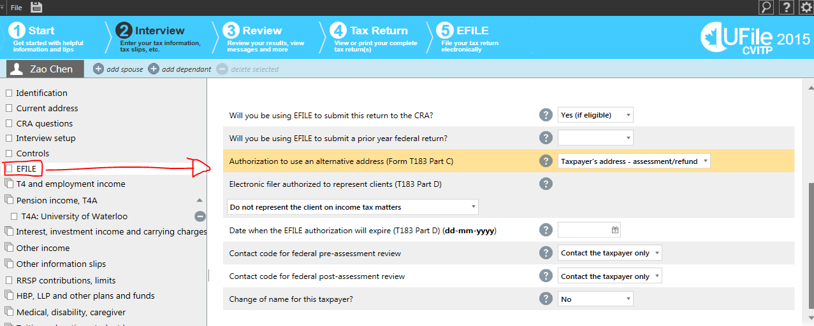
Step 2: EFILE
Leave at default
Notes:
Accidentally changing one of these may result in the CRA sending a notice to you or AFSA asking to see the taxpayer’s rent receipts or similar. Not what we want!

Slide 67
Post-preparation
Tell them:
Amount Owing/Refund
GST/HST Credit Estimate
Ontario Trillium Benefit Estimate
See previous example of Zao Chen
Notes:
For the income you’ve earned this year, you have an amount owing (refunded) of __________.
“The Government of Canada is paying you an HST credit of _______. This is a credit paid to people with low-income such as students.”
“The Province of Ontario is paying you _________. _________ is because you have low-income and ________ is for paying rent/property tax during the year.” (See example form http://csclub.uwaterloo.ca/~ekfong/taxclinic2015/ReadingOntarioForm.pdf)

Slide 68
Post-preparation
Easy way of finding numbers
Generate a PDF
CTRL+F for:
“Refund or Balance Owing”
“Goods and Services Tax Credit”
“Estimated ontario trillium benefit”
Notes:
For the income you’ve earned this year, you have an amount owing (refunded) of __________.
“The Government of Canada will pay you an HST credit of _______. This is a credit paid to people with low-income such as students.”
“The Province of Ontario is paying you (Line 57). (Line 54) is because you have low-income and (Line 55) is for paying rent/property tax during the year.” (See example form http://csclub.uwaterloo.ca/~ekfong/taxclinic2015/ReadingOntarioForm.pdf)

Slide 69
Post-preparation
Have client fill in TIS60 form, and sign Section 1
If and only if the return was EFILE’d, then you and the client must sign Section 2
PAPER FILE: tell them to sign the bottom of page 4 of the Jacket (the page with the balance owing/refund) and the line for Signature. SHOW THEM ON THE PDF.

Slide 70
Post-preparation
Give USB (?) or email return
If emailing them, have them log into THEIR email on your laptop and attach:
UFILE file (set password to ‘password’)
PDF of their return
Notes:
We’ve had issues in the past where returns were sent to the wrong student, and/or returns were sent from personal emails. Please make sure that they don’t leave until they send it to themselves.

Slide 71
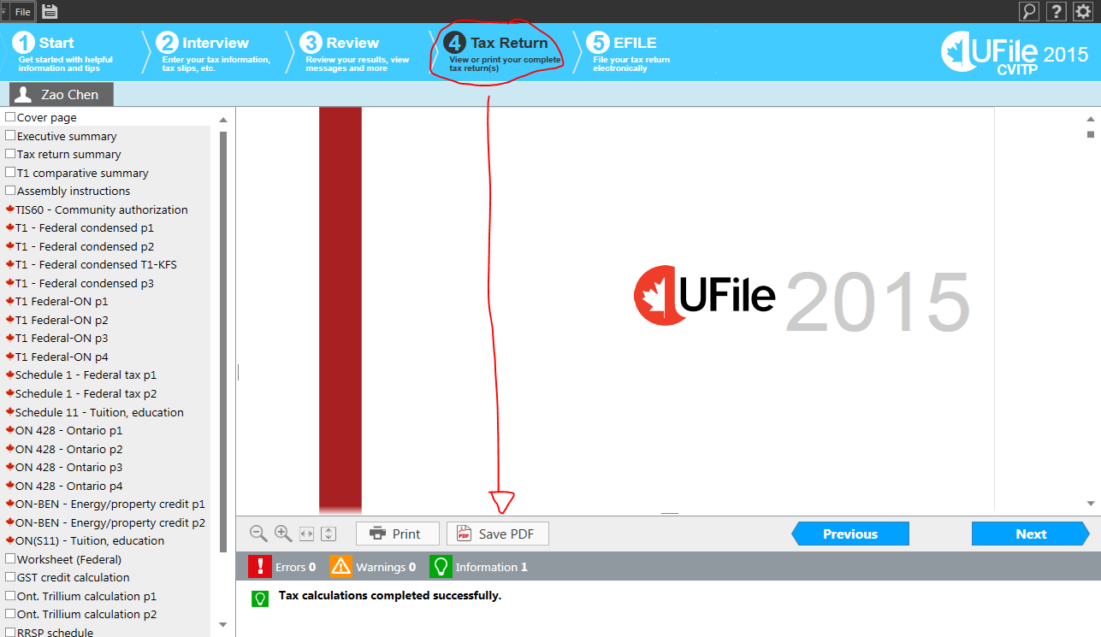
How to Generate PDF

Slide 72
Using Pt2
Long Beach, WA

Slide 73
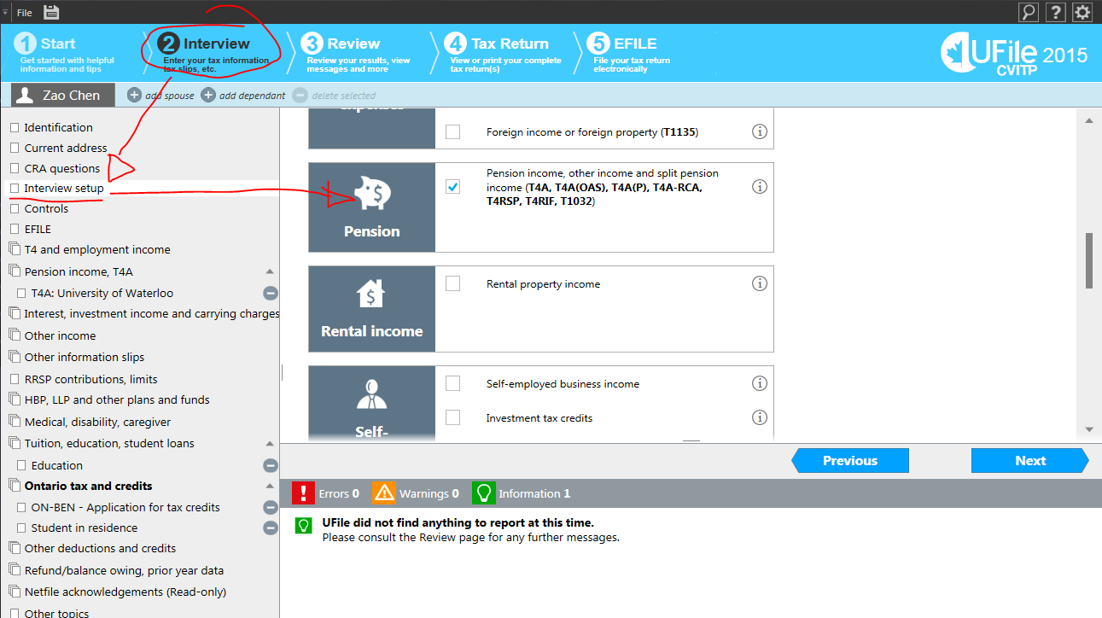
INCOME!
HORRIBLY MISTITLED!
Notes:
This checkbox actually includes ‘RESP Income’, ‘Scholarship Income’, and ‘Other Income’. If you’re holding a slip that says ‘T4A’, check the box.

Slide 74
Step 2: Employment Income
T4 – Enter all boxes listed (leave blank if 0)
Tips – Waiters must declare tips received as income
Other Employment Income
VERY RARE (comments)
Notes:
Other Employment Income is narrowly defined as a list of certain sources, none of which are relevant here.
http://www.cra-arc.gc.ca/tx/ndvdls/tpcs/ncm-tx/rtrn/cmpltng/rprtng-ncm/lns101-170/104/menu-eng.html
The rare case is a student insisting they want to declare the $10 - $20 income for participating in a study on campus (they are absolutely right).

Slide 75
Super Easy Example
Lynn Wu
DoB: 1993-07-17
SIN 535 353 585
Home and Mailing Address:
803-8 Hickory St W, Waterloo, ON, N2L 3H6
Single
Not her first time do tAX
Lives in parents’ basement (no rent!)
Has direct deposit information (see next)
See next slide for T4

Slide 76
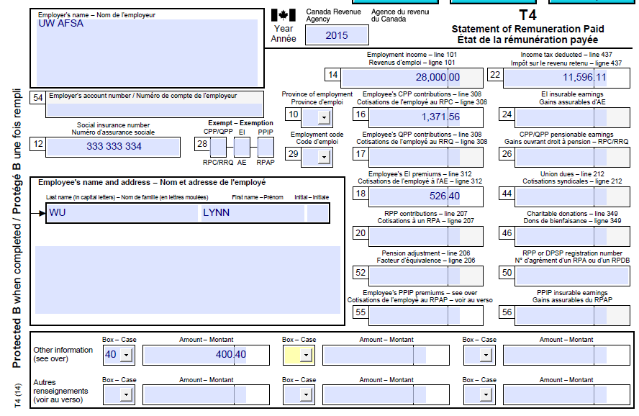
Notes:
If there is a box on the T4 not listed on UFILE’s form, there is a dropdown on the bottom for additional boxes.
Some boxes are not required. If it’s not listed, not required.
If in doubt, please ask.

Slide 77
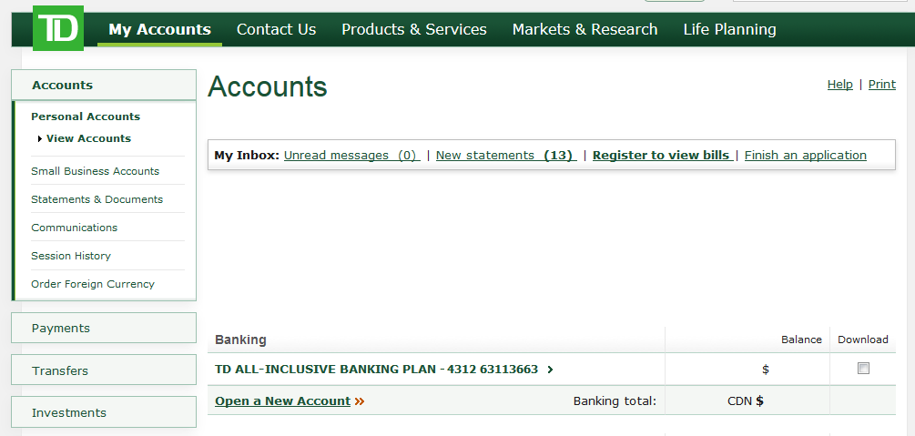
Lynn’s Direct Deposit

Slide 78
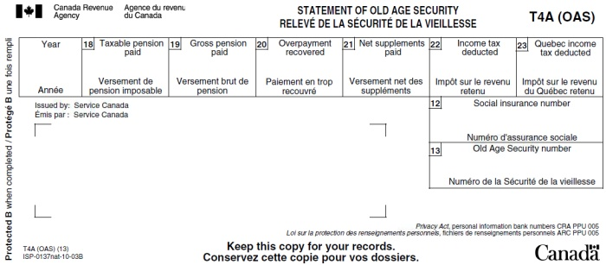
Interview Setup - Income
Pension Income (and other income)
T4AOAS

Slide 79
Interview Setup - Income
Pension Income (and other income)
T4AP (NOT THE REAL SLIP… but it’s pink!)
Notes:
This is actually not the real slip, but I couldn’t find one online….. It is pink though!

Slide 80
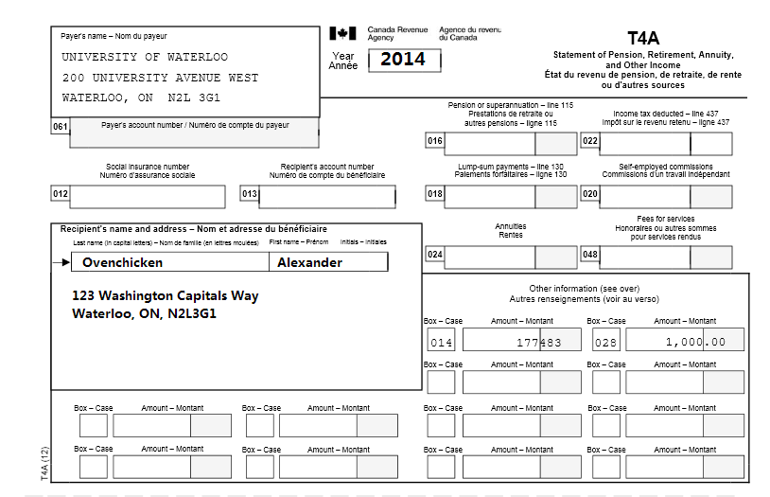
Interview Setup - Income
Pension Income (and other income)
T4A (Other Income)
Notes:
This slip shows Box 28, Other Income
Note that for some reason, UFILE has lumped in all T4A’s as ‘Pension Income’

Slide 81
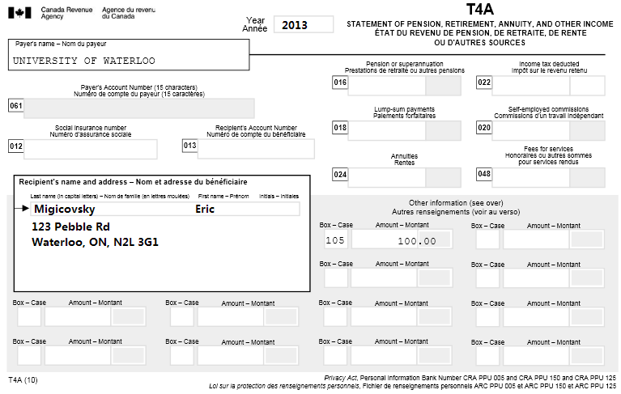
Interview Setup - Income
Pension Income (and other income)
T4A (Scholarship Income)
Notes:
This slip shows Box 105, Scholarship Income
Note that for some reason, UFILE has lumped in all T4A’s as ‘Pension Income’

Slide 82
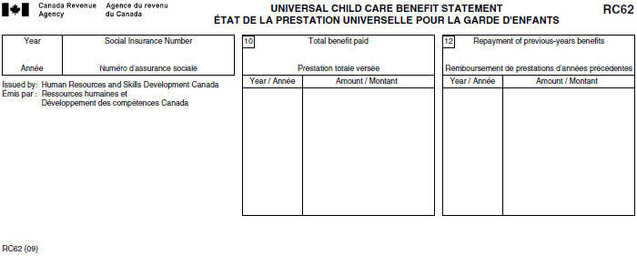
Interview Setup - Income
Universal Child Care Benefits
RC-62 Slip (from government)
Notes:
This slip shows Box 105, Scholarship Income
Note that for some reason, UFILE has lumped in all T4A’s as ‘Pension Income’
IF THEY HAVE ONE, they have a kid.
Please ask about childcare expenses, child fitness/arts activities, etc.

Slide 83
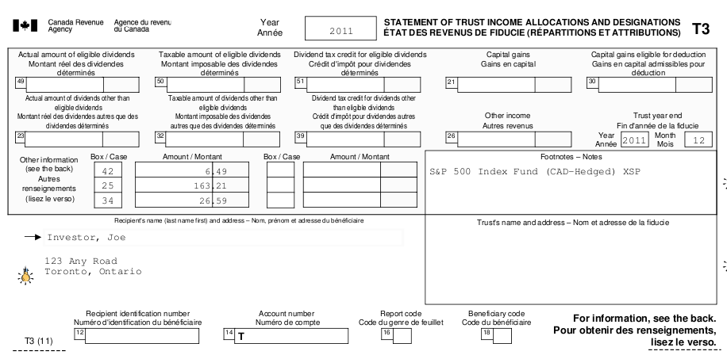
Interview Setup - Income
T3 – Trust Income
Notes:
Usually received from investing in mutual funds – INVESTMENTS
Can also receive, if they are the beneficiary of say a family trust
Will say what it’s from. If it’s the former, make sure they didn’t buy or sell anything (or else we can’t help them)

Slide 84
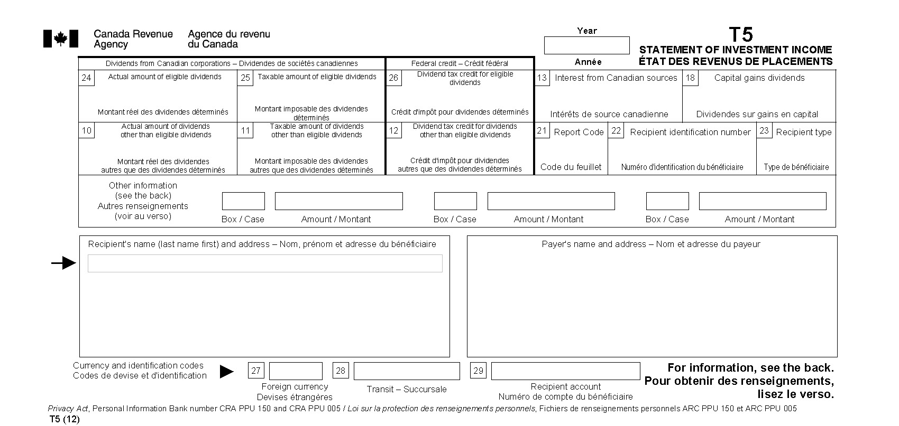
Interview Setup - Income
T5 – Investment Income
Notes:
Interest, dividends, foreign investment.
make sure they didn’t buy or sell anything (or else we can’t help them)
Also >$1000 interest income (Box 13) means we can’t help them

Slide 85
Interview Setup - Income
Other things on the Investment Page:
T4PS – Employee Profit-Sharing Plan
Notes:
Interest, dividends, foreign investment.
make sure they didn’t buy or sell anything (or else we can’t help them)
Also >$1000 interest income (Box 13) means we can’t help them

Slide 86
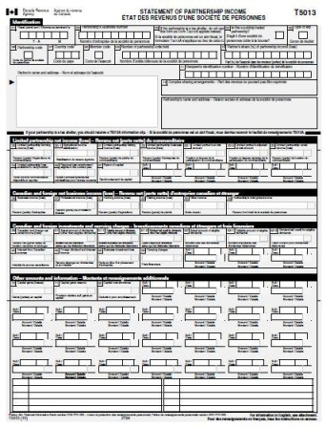
Interview Setup - Income
T5013 – Partnership Income
Full-page slip
You will 99% sure not see this

Slide 87
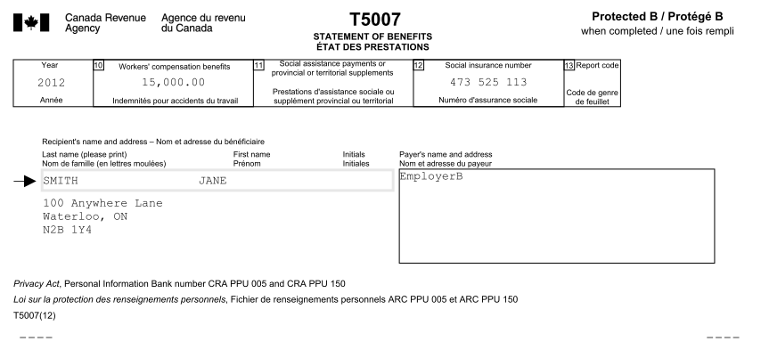
Interview Setup - Income
T5007 – Statement of Benefits
Notes:
Usually for EI (employment insurance) benefits

Slide 88
Interview Setup - Income
Alimony or Support Payments
No slip, this will probably be in a separation agreement or other legal document
We don’t need to see
Take their word

Slide 89
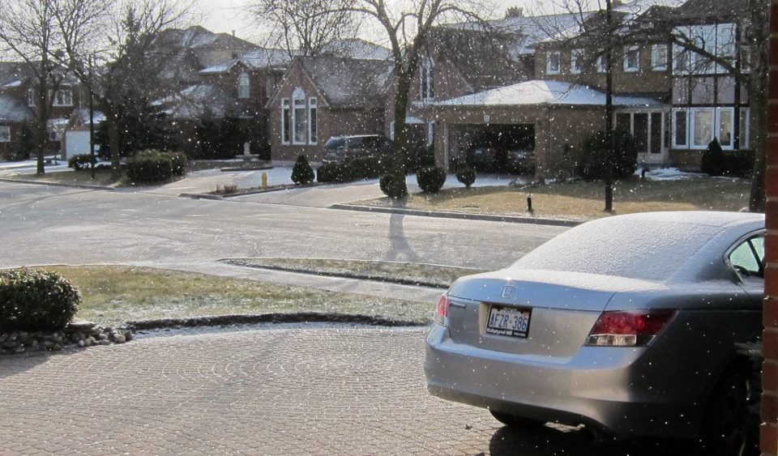
Using Pt3
What Winter’s Supposed to Look Like

Slide 90
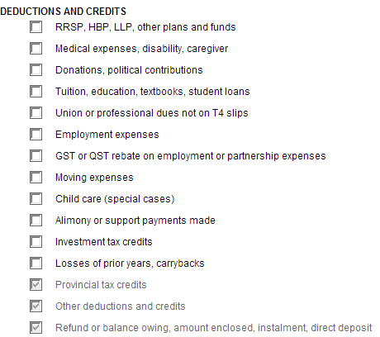
Deductions and Credits

Slide 91
RRSP Contributions (Deduction)
What is an RRSP?
Something the government designed to encourage retirement savings!
Deduction now, taxed on withdrawal (presumably when you’re retired)
RRSP Contribution Limit
Generated by employment income
Carries forward if not contributed
Get last year’s carryforward from Notice of Assessment (best!) or last year’s tax return
Notes:
RRSP is only effective if you have a lower income tax rate when you’re retired compared to when you take the deduction.
Also, notice that the investment income you earn inside the RRSP is not taxed, it’s held within the RRSP and can earn more investment until you withdraw the money.
See the links (tinyurl.com/allthosedocs) for the sample notice of assessment

Slide 92
RRSP Contributions
Financial Institution will give you an ‘RRSP Contribution Receipt’
Contributions will be divided between:
‘First 60 days of 2016’
Remainder of the 2015 year
Can also contribute to spouse’s RRSP
Use your contribution room
When spouse withdraws a long time from now, taxed in their hands
Notes:
The government allows you to make a contribution in the first 60 days of the 2014 year (It’s not Mar 1 yet!) and let you deduct it for 2013 taxation year

Slide 93
RRSP Contributions
Overcontribution
First $2,000 over limit is ok, no penalty
Will probably be some warning bells if over, talk to us!
Notes:
We may have to figure out if there’s a way to take the money out to minimize penalties.

Slide 94
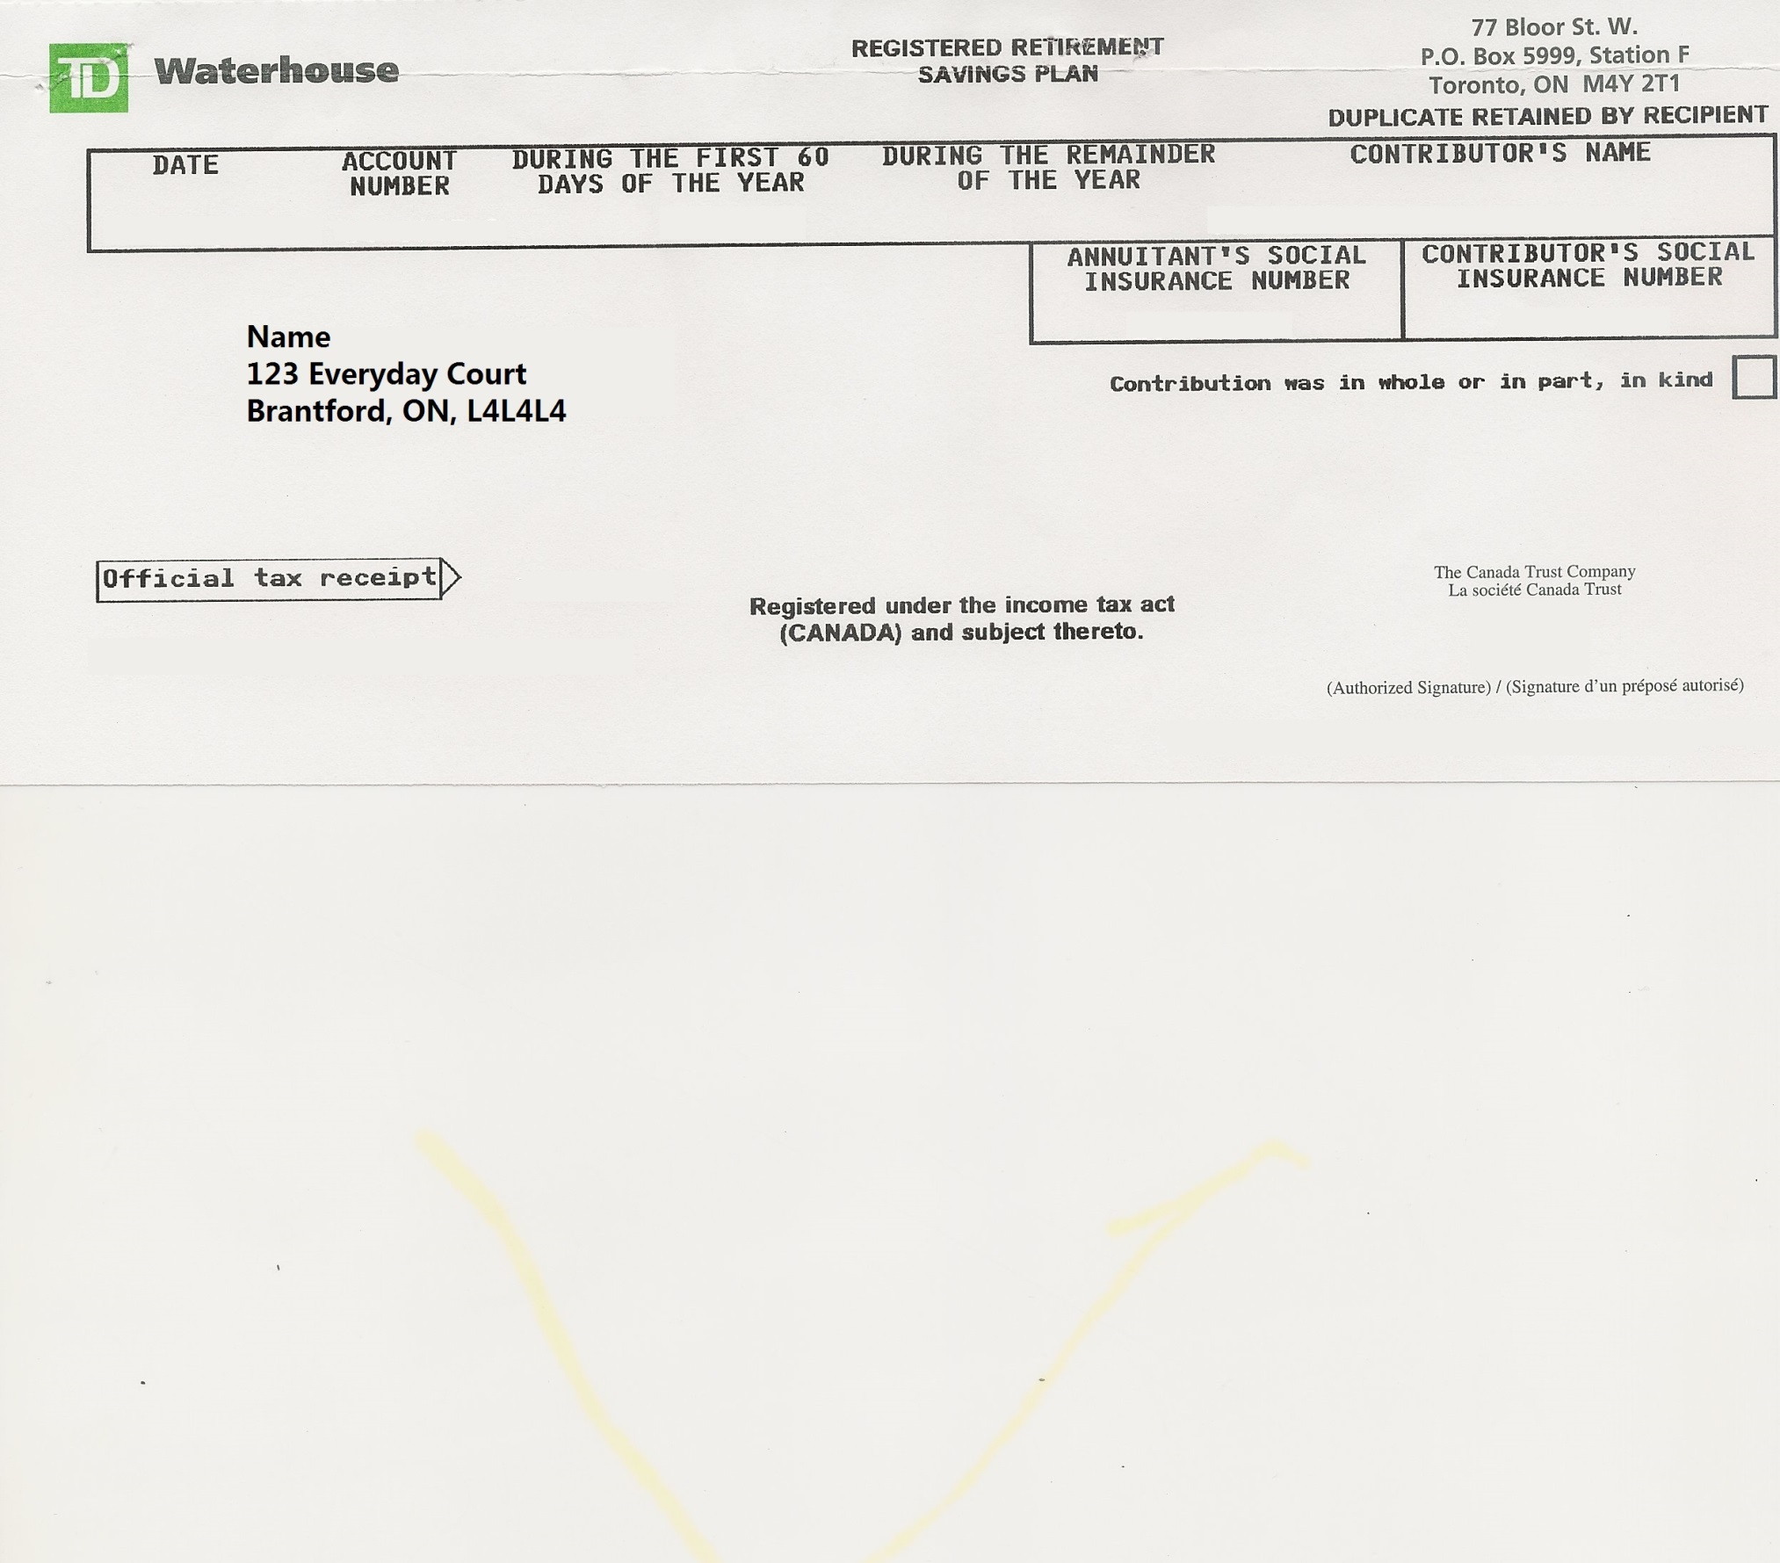
RRSP Contributions
All receipts look different, here is TD
Notes:
We may have to figure out if there’s a way to take the money out to minimize penalties.

Slide 95
Medical Expenses (Credit)
Need to have tax payable to have effect
Credit received reduced by 3% of net income
Quickly guesstimate 3% of net income
If medical expenses are below or only slightly over that amount, don’t bother
Ask us if you want some judgement help
Notes:
Note that there is actually a lesser of calculation here. For the purposes of the tax clinic, no one will have >$70k income so it is not relevant.
For your interest,
The total amount of medical expenses is subtracted by:
Lesser: i) $2125, ii) 3% of Net Income
This is the amount you get as your credit

Slide 96
Medical Expenses
Only certain medical expenses are eligible
In general, most things sensible count
Prescriptions, Dental, Optometry
But, no over-the-counter drugs (ie. Things that don’t require a prescription can’t be claimed)
Check list here:
http://www.cra-arc.gc.ca/tx/ndvdls/tpcs/ncm-tx/rtrn/cmpltng/ddctns/lns300-350/330/llwbl-eng.html
Notes:
http://www.cra-arc.gc.ca/tx/ndvdls/tpcs/ncm-tx/rtrn/cmpltng/ddctns/lns300-350/330/llwbl-eng.html

Slide 97
Medical Expenses
Timeframe
Can claim any date range of 365 days that ends in 2015
Client might have more medical expenses from Mar 20, 2014 to Mar 19, 2015
Can’t claim the same medical expense in two different years

Slide 98
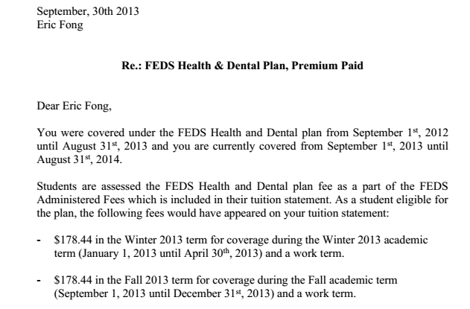
Medical Expenses
Things people will bring
University Health/Dental Insurance

Slide 99
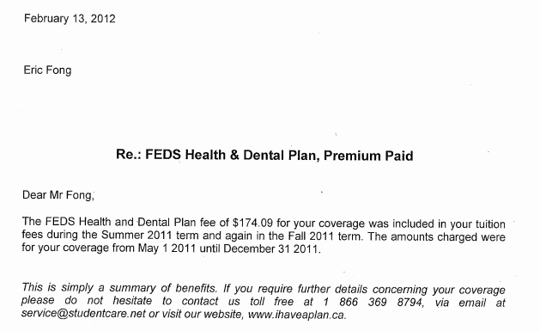
Medical Expenses

Slide 100
Medical Expenses
Definitely transfer to parents if student is born in 1996 or later
Otherwise, transfer only if:
Medical expenses >3% child’s net income
Eg. 0 income, definitely transfer!
How do you transfer?
Get the child to give the receipt to parents. No further action required.

Slide 101
Should I Input that Medical?
Born after 1997
Yes
If Unsure how to do this step, just enter it UNLESS it’s a big stack of receipts
No
Did they make money!?
No
Yes
Do they pay tax?
No
Unsure
Yes
Has Cdn Parents
Tax Mentor
Yes
No
Tell them to GIVE receipts to Parents
Do not Claim
Claim
Notes:
There is no downside to the client if you enter their medical receipts into the program. Unlike donations, they will not miss future tax saving opportunities. The only problem is if a client brings a shoebox of medical receipts, we will need them to help us total the receipts.
Has Cdn Parents => Do they have parents earning income in Canada who would be able to use it?
Net Income can be found on the Jacket page 3

Slide 102
Political Contributions
Not the same as charitable contributions
Need to mail in receipt with return if paper file
Represents donation to Federal, Provincial or Municipal candidate (or party)

Slide 103
Should I Claim that Donation?
Have they donated previously in 2007-2012?
Yes
No
Eligible for FDSC
Is the total amt of donations significant?
Yes
No
Do they owe taxes? (ie. Net Federal Tax on Jacket Pg4 > $0)
Yes & No
Unsure
Ask a Tax Mentor
Claim
ADVISE not to claim
& Explain Why!
Notes:
Just claim the donation.

Slide 104
Charitable Donation Receipts
Charity receipts will have certain identifying marks
Registered Charity xxxxx xxxx RR 0001
Need to mail in receipt to CRA if paper file
Can carryforward for 5 years
Changes in 2013!

Slide 105
Charitable Donation Receipts
Eligible for the First-Time Donor Super-Credit (FDSC)?
Did not claim a donation on all tax returns between 2007-2014
If they never made a significant amount of money before (>11k) or never claimed donations on tax return, safe to say yes
What is FDSC?
Non-refundable Tax Credit (BONUS 25%! In addition to normal 15%)
Does not carryforward
Notes:
Yes, they actually called it a ‘super-credit’.

Slide 106
Charitable Donation Receipts
FDSC – Decision Time
Do not claim donations for anyone who will not be able to use credit, that is
Did not claim donations in the previous 5 tax years (ie. eligible for FDSC)
Either
Has no taxes payable
Has taxes payable, but has tuition credits to carryforward
Goal is to preserve student’s ability to claim donation credit in the future, since it is valuable (up to $250 in cash!)
Notes:
Just claim the credit.

Slide 107
Charitable Donation Receipts
Other Donation Cases
US donations
Prescribed universities outside of Canada

Slide 108
Tuition Receipt T2202A
Always enter!
Tuition, Education and Textbook CREDITS are all generated from this slip
Education and textbook amounts are calculated on a per-month of study basis
Don’t need to know how much you actually spent on textbooks (clients/parents always bring textbook receipts we don’t need them!)
Don’t need to mail in slip if paper file

Slide 109
Tuition Receipt T2202A
YOU MUST ENTER MONTHS!!!!

Slide 110
Tuition Receipt T2202A
Unused amounts are carried forward
Best way is to get from notice of assessment (it will be in a bunch of paragraphs)
Excerpt:
Otherwise, last year tax return, see ‘Schedule 11’

Slide 111
Tuition Receipt T2202A
Even better than carryforward is transfer to parents
ALWAYS ENTER THIS SLIP EVEN WHEN TRANSFERRING!
Action IS required in order to transfer to parents
From the drop-down list, choose
‘Transfer to parent not processed’
Leave fields below that blank
Tell student to give an extra copy of THEIR tax return to their parents so they can claim the transferred tuition credits!
Notes:
The actual numbers the student needs to give to the parents are on Schedule 11 and ON Schedule 11 of their tax return.

Slide 112
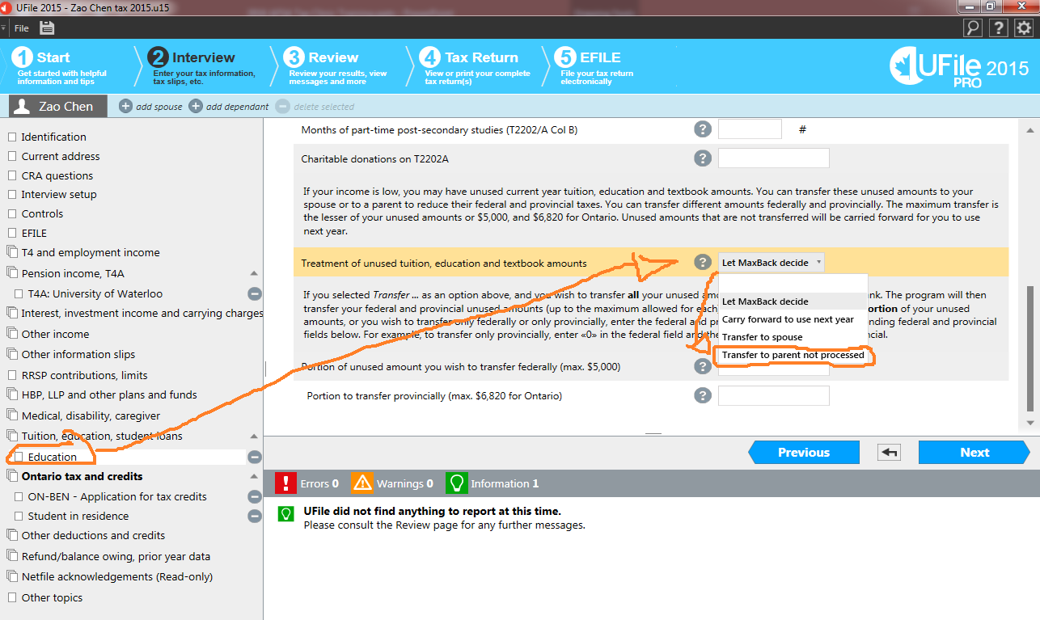
Transfer to Parent

Slide 113
Interest paid on Student Loans
Will receive a statement that explicitly mentions the deductible portion for tax purposes – remember you only pay interest once you’re out of school!
Only deductible if the student loan is from the government.
You can also find this ONLINE on the NSLSC website.

Slide 114
Union/Professional Dues (Deduction)
Union dues normally already recorded on T4
Professional dues (eg. CPA Ontario) are usually not recorded on T4
Don’t need to mail in receipt if paper file

Slide 115
Moving Expenses (Deduction)
Rare
Moving closer to school
Can only deduct against taxable scholarships, bursaries, etc.
No!
Moving closer to work
Eg. Moving from Waterloo -> Toronto to your parent’s house counts

Slide 116
Moving Expenses Pt1
Choose Simplified Method unless either:
They flew on a plane, or
All of:
They have receipts
The total of receipts is more than simplified method
Simplified method calculated automatically (use Google Maps to calculate distance)
$0.55 / km travelled, + $17 / meal while travelling (max 3 meals/day)

Slide 117
Moving Expenses Pt2
Detailed Method – Need receipts (eg. Receipt for flight + cost of shipping bags)
Only relevant for this tax clinic if they moved 40km or more for work
Eg. If I move from Waterloo to Toronto for co-op / summer job, then I moved >100km so we should deduct!
Use Google Maps to assess distance.
Notes:
There is also a note here that if you move for school and have taxable scholarships, you can also deduct moving expenses.
But you don’t have taxable scholarships in 99.9% of the cases so this is left as a note for completeness.

Slide 118
Moving Expenses Pt3
You will also choose simplified vs. detailed on this screen.

Slide 119
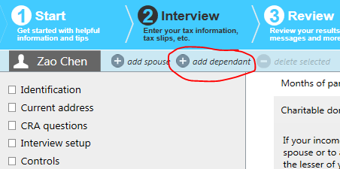
Childcare Expenses (Deduction)
Create a family member for the child (top left corner of program) and enter on child’s ‘interview’
Common Examples:
caregivers providing child care services;
day nursery schools and daycare centres;
educational institutions, for the part of the fees that relate to child care services (eg. Private schools)
Summer Camps (also March Break, etc. any camps)

Slide 120
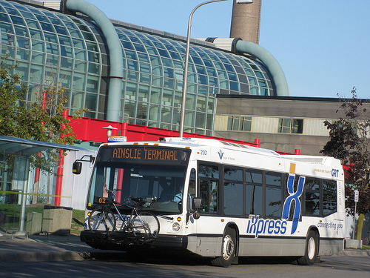
Using Pt4
Waterloo, ON

Slide 121
Other Specific Things!
Notes:
This is the list from the old program. (UFILE 2014 and earlier)

Slide 122
Transit Pass Amounts (Credit)
Only useful if there is tax payable!
Don’t need to submit with paper file
Sometimes, already listed on T4 (eg. if provided by employer), don’t enter again
Lots of sources (UW: http://feds.ca/upass)
PRESTO card
FEDs UPASS (all undergrad students)
GSA UPASS (all grad students)
Other Local transit (eg. York Region Transit (YRT), Toronto Transit Commission (TTC))
Notes:
There is no downside to the client if you enter their transit passes into the program. Generally, don’t even think about it unless they have income.

Slide 123
Transit Pass Amounts
Should be claimed by parent if:
Under 19 years of age at Dec 31, 2015
If Claimed by Parent:
Tell them to physically give receipt to parents to claim on their tax return
Do not claim on student’s return
Notes:
Here is tax planning at its simplest. You can claim the credit on the student’s return or the parent’s return. Student probably pays no tax. Parents probably pay tax.

Slide 124
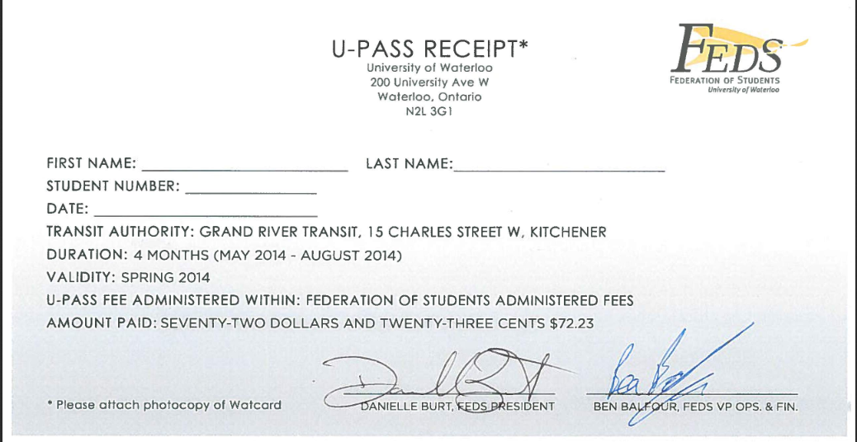
FEDS UPASS
Have student download and fill in receipt from FEDS site
http://www.feds.ca/about/upass/

Slide 125
PRESTO Statement
You can claim the cost of any 32 or more one-way trips:
Taken on a single transit agency, and
During an uninterrupted period of 31 days or less.

Slide 126
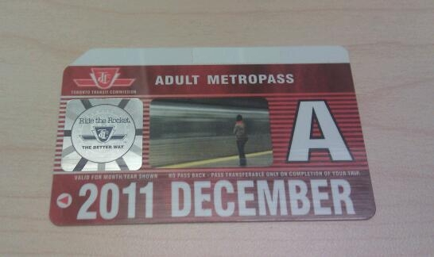
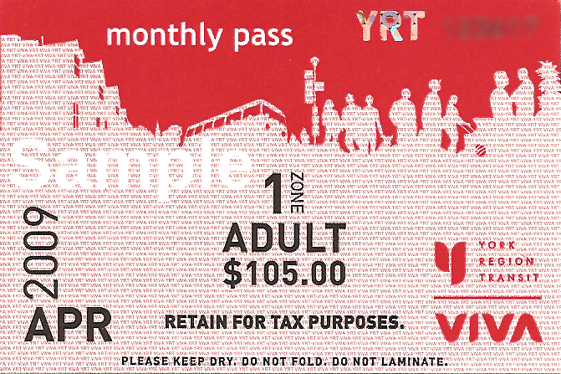
Monthly Transit Passes
They MUST keep the actual transit pass in case CRA asks!
We don’t need to see it, but it’d be nice

Slide 127
Transit Pass Flowchart
Has Cdn Parents?
Are they under 19 on Dec 31, 2015?
Yes
Yes
No
No
Has Income?
No
Yes
Parents:
Tell Client to GIVE receipt to parents to claim on their tax return
Do not Claim
Claim
Notes:
There is no downside to the client if you enter their transit pass receipts into the program. Unlike donations, they will not miss future tax saving opportunities. The only problem is if a client brings a shoebox of medical receipts, we will need them to help us total the receipts.
Has Cdn Parents => Do they have parents earning income in Canada who would be able to use the credit? (eg. Intl students may not)

Slide 128
Home Buyer’s Amount
Very very very unlikely to come up
Ask us

Slide 129
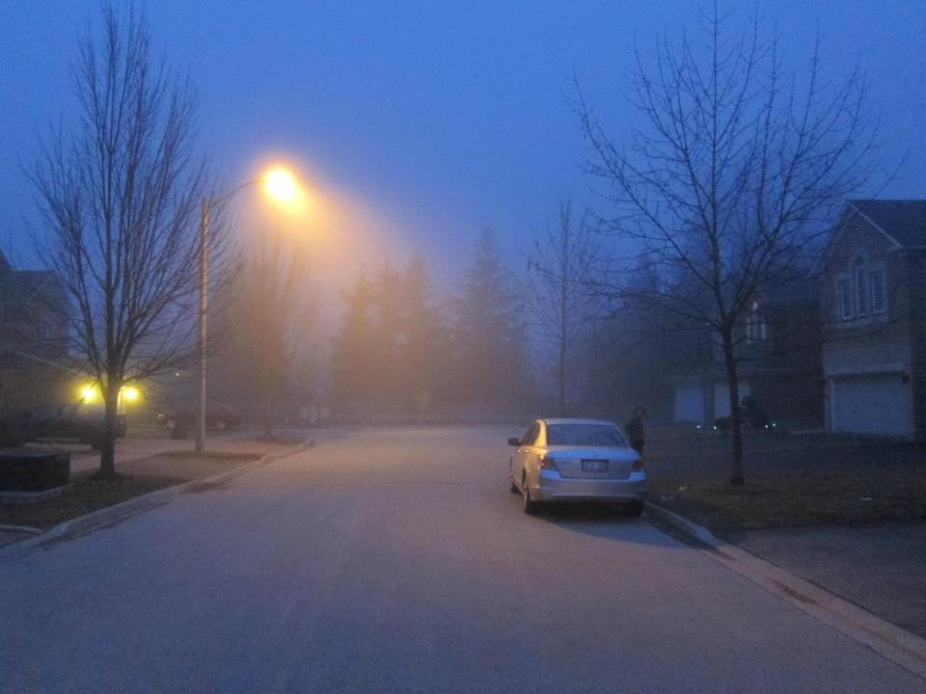
Using Pt5
Richmond Hill, ON

Slide 130
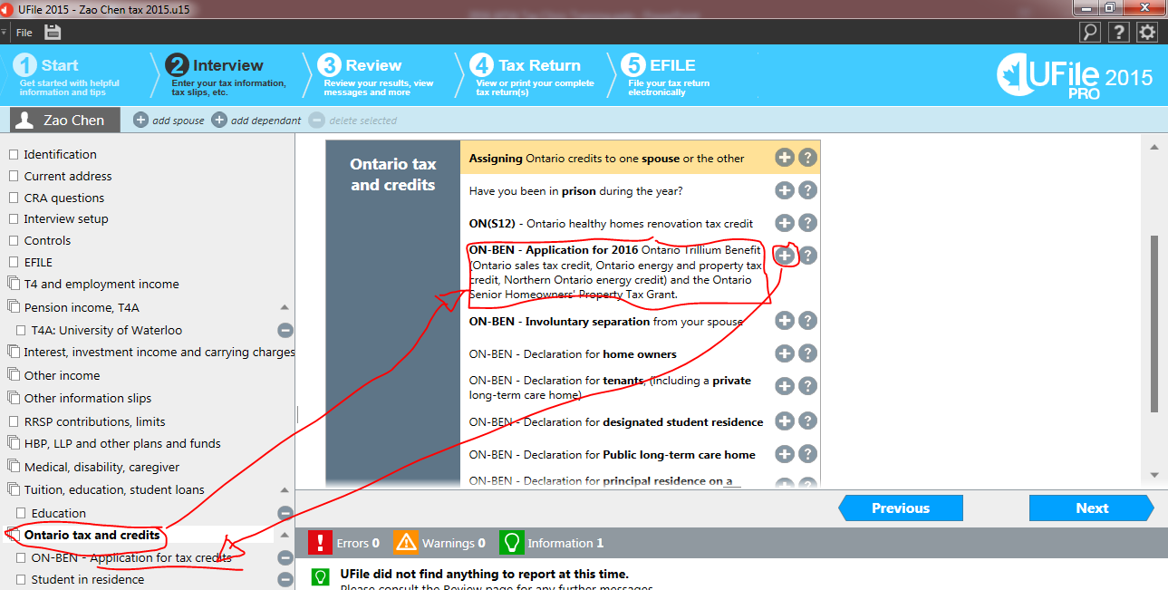
Ontario Credits

Slide 131
ON-BEN Application for […]
Fill in the yes on the second drop-down where it says
“Applying for the 2015 Ont. energy and property tax credit”
Will not receive up to $500 worth of credit if you don’t!!!!
Do not fill the first drop-down list!
Notes:
Not very intuitive, weird Ufile would set it up this way….

Slide 132
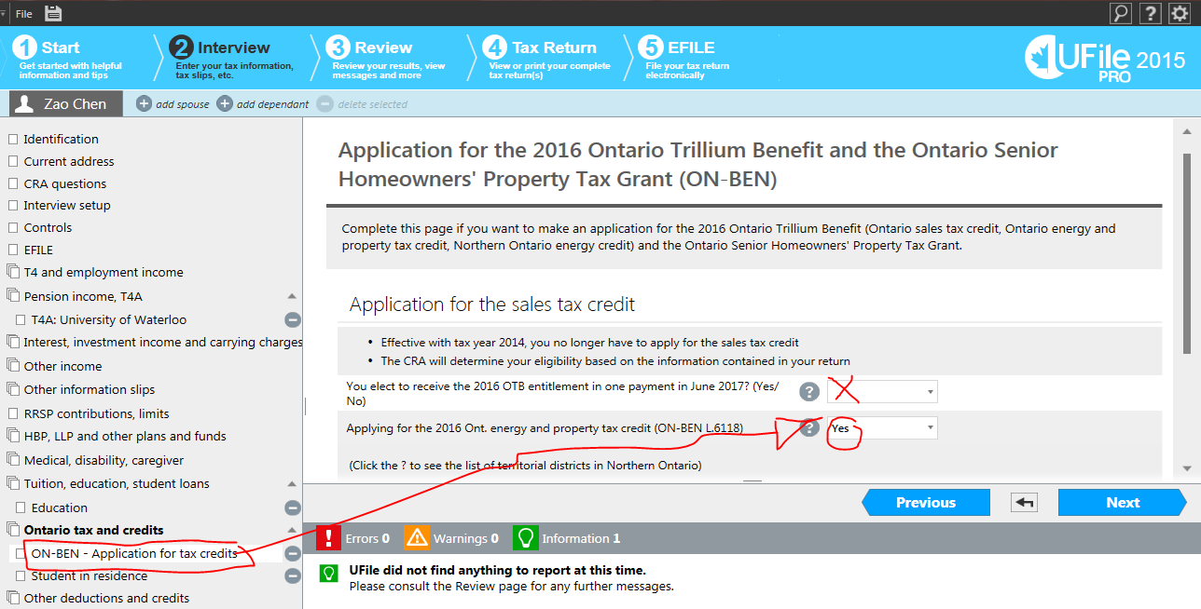
ON-BEN Application for […]
Notes:
Not very intuitive, weird Ufile would set it up this way….

Slide 133
Ontario Energy and Property Tax Credit (OEPTC)
Residence
Don’t need receipt
Don’t need amounts paid
Client will get $25 paid out separately from tax return

Slide 134
Designated Student Residence

Slide 135
Ontario Energy and Property Tax Credit (OEPTC)
Rent / Sublet (often REVIEWED by CRA)
Client has receipt: OK!
Client paid by cheque: OK!
They can get cheque copies from the bank as proof
Client has neither: Not OK!
Life lesson: ALWAYS pay rent using cheques!
Suggest they ask for a receipt
Ask them if they think they can get a receipt and claim only if they think they can
Client can get LOTS of money back from the OEPTC (up to $500!)
Ontario Only
Co-op in Calgary? Sorry out of luck!
Notes:
This is the main reason why students should file a tax return even if they make nothing.

Slide 136
Ontario Energy and Property Tax Credit (OEPTC)
Only rent costs paid
Can’t claim hydro
If lease includes hydro, no adjustment necessary!
No other costs claimable
Sublet:
Claim with receipt from sublettor
Sublettor does not have to claim rental income
Notes:
This is the main reason why students should file a tax return even if they make nothing.
I assumed sublettor is not making a profit on the sublet

Slide 137
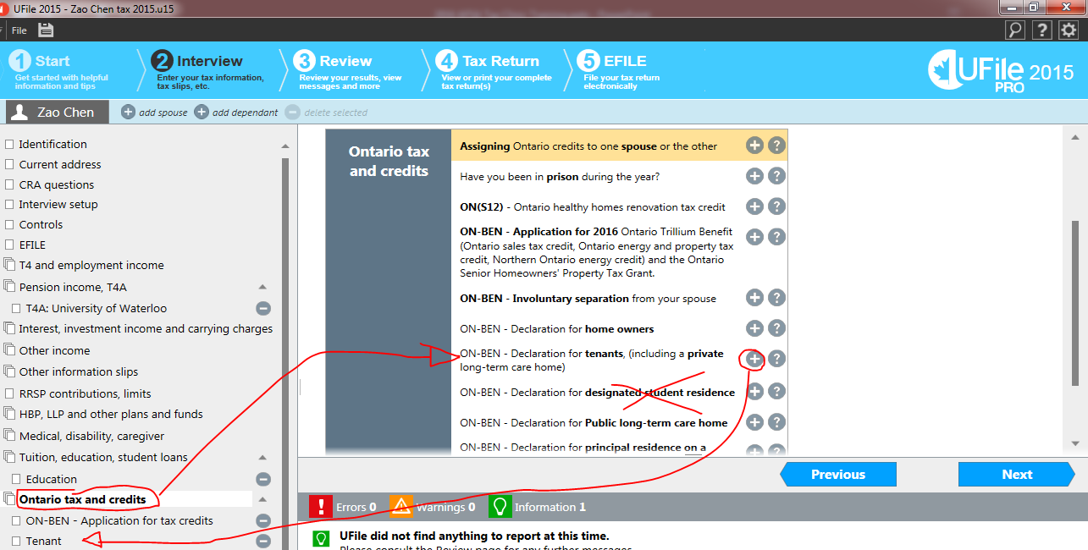
Renting in Ontario

Slide 138
Ontario Energy and Property Tax Credit (OEPTC)
Property Tax
We don’t need receipt, not needed to file return, just the amount
Need the actual amount required (for Toronto, these come out halfway through the year I *think*), NOT the estimates that they give at the start of the year
If you do see a document, there will be a VERY clear line that says total property tax for 2013
Notes:
This one should be rare because students. Also, note that if they’re paying property tax, they own a house. If they own a house and are renting to friends, we can’t help them!!!

Slide 139
Another Case!
Name: Anna Liang (SIN 333-333-334) – July 11, 1994
No tuition, no income, not first time filing
Rent: 604-202 Lester St, Waterloo, ON, N2L 3W4
Landlord: KW4RENT
September 1, 2014 – August 1, 2015
Paid:
Rent: $700 / mo
Hydro: $50 / mo
Internet $25 / mo
Damage Deposit: $200
Lived in MKV for Sept 1, 2015 – Apr 30, 2016
Paid $800 / mo for residence

Slide 140
Fitness/Arts Credit
Go to the child’s ‘interview’ and enter information there
Claim up to $1,000 (for Ontarians) in Fitness
$500 in Arts
Don’t need to submit receipts
Notes:
*NEEEEWWWWWW****
Eligible activities for the children’s arts tax credit include artistic or cultural activities such as art classes, piano lessons, and tutoring, as well as other activities that are intended to improve a child’s dexterity or co-ordination.
Eligible activities for the children’s fitness tax credit include strenuous games like hockey or soccer and activities such as golf lessons, horseback riding, sailing, and bowling, as well as others that require a similar level of physical activity.

Slide 141
Family Tax Cut
Tax cut for rich people
Notes:
This is Harper’s Tax Cut for the Rich.

Slide 142
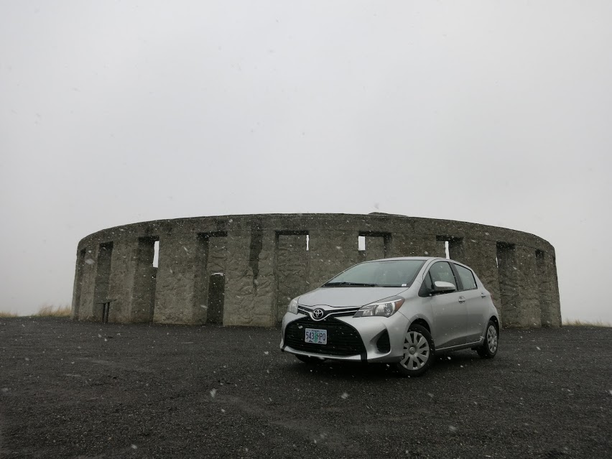
Last Random Topics
Fake Stonehenge, OR

Slide 143
Application for an ITN
Individual Tax Number (for non-residents)
For people who aren’t eligible for a SIN and don’t already have an ITN
http://www.cra-arc.gc.ca/E/pbg/tf/t1261/README.html
Complete but don’t sign!
Needs to be certified (see next slide)

Slide 144
Application for an ITN
Meet a Commissioner of Oaths:
https://uwaterloo.ca/secretariat-general-counsel/notaries-and-commissioners-taking-affidavits
Bring:
Form (unsigned)
Original Watcard + 2x photocopies (front+back)
Original + 2x photocopies of a supporting doc

Slide 145
Application for an ITN
Completing the Return:
Use 333-333-334 as the SIN and tell them to white it out after printing (if they are confused / English is not good, please show them white-out)
Other Issues:
Important that their mailing address is good for at least a year! – only way to get the ITN so that you can file next year!
It takes a long time to process the first return (1/2 a year on average)

Slide 146
Doing Old Tax Returns
Do we have UFILE codes for 2014 and older (?)
A mentor or tax preparer specialist can do them
1) Did you do a return last year? If no:
When did you arrive in Canada?
Will you be 19 on April 1, 2016? If so, file 2014 return (and any earlier if applicable)

Slide 147
EFILE Errors
Sometimes EFILE doesn’t go through
Can look up what the EFILE Error means from this list:
http://www.cra-arc.gc.ca/E/pub/tg/rc4018/rc4018ch2-14e.pdf
Can ask mentor for help
Can also paper file (just tell them to do this if busy)

Slide 148
Making Mistakes
Confirm before pressing EFILE.
Can’t reverse – always go over return with client before filing!
To correct, after they receive notice of assessment, they can file a T1-ADJ
http://www.cra-arc.gc.ca/E/pbg/tf/t1-adj/README.html

Slide 149
Foreign Employment Income
“My co-op was in Japan/California/Yemen”
Their responsibility:
File an income tax return in Japan/USA/Yemen
Our role:
Enter foreign income + foreign taxes paid (see notes below)
Must ask a mentor to help or review!
Notes:
Choose ‘Foreign Income’ in Interview
Choose ‘Foreign Employment Income’
Select Country
Description: Type “Employment Income”
Exchange Rate to Apply: Use the Bank of Canada exchange rate for 2015 according to the currency
http://www.bankofcanada.ca/rates/exchange/annual-average-exchange-rates/
Foreign employment income not entered on a T4 page: Enter income in original currency (eg. Japanese Yen)
Amount of foreign tax paid: Enter this based off of their foreign tax return and in original currency (you will need a mentor to help you)
Input income earned in foreign currency

Slide 150
Direct Deposits
View Online Bank Account
Look for ‘Direct Deposit Form’ or ‘Void Cheque’
Ask Mentor for help
See Notes on this slide for lots more info per bank
Notes:
Institution Number represents the bank, it is unique to each bank
Branch/Transit: Represents which bank branch you first opened your account at (for many intl students, this is the one in the SLC basement)
Account #: Unique to each student, can usually find through online banking
TD: You can get most of the information off of the “My Accounts” screen.
https://td.intelliresponse.com/accounts/index.jsp?requestType=NormalRequest&source=4&id=218&question=How+do+I+identify+my+
Tangerine: Click into the Chequing Account. Under ‘Account Actions’ choose ‘Print void cheque’. A window with PDF of a void cheque appears, use information on bottom
Institution: 614
Branch/Transit: 00152 (same for all)
BMO: Click into the chequing account. Each item will be listed along the top of the page
Account No: xxxx-xxx (enter this without hyphen) Financial Institution No: 001 Branch Transit No: yyyyy
PC Financial
Institution Number: 010 (same as CIBC)
Branch/Transit: 30800 (same for all)

Slide 151
Other Topics – FYI
Why File a Return if you don’t have to!?
HST Credit
For 2015 return, will you be 19 by April 1, 2017? If so, you should file a return
Transfer tuition credits to parents
Note that an international student may not have any parents with Cdn income to transfer to
Ontario Trillium Benefit
The credit you get is based off income.
Should do if in 2015 either 1) lived in residence, or 2) lived off-campus and paid rent
Refund of overpaid tax (if there is employment income)
Purposefully make withholdings higher than estimated tax to encourage people to file

Slide 152
Other Topics – FYI
Who we CAN NOT prepare returns for
See list on our website (uwafsa.ca/taxclinic)
“The company I worked at during co-op said I could be an ‘independent contractor’ and paid me without a T4
This is ‘Self-Employed’ income
Check dates/year of all slips/receipts
Lots of people make mistakes
Clients at work send wrong years all the time
Notes:
Regrettably, we will not be able to prepare your return if it involves any of the following items:
‧ Rental income and expenses
‧ Business income and expenses (eg. including self-employment income)
‧ Disposition of marketable securities (eg. Capital Gains/Losses on sales of shares)
‧ Employment expenses (eg. form T2200 signed by your employer)
‧ Bankruptcy
‧ Deceased persons
‧ Interest Income over $1000
‧ Total income above the following income thresholds:
Taxpayer status Family income
Single person $30,000
Couple $40,000
One adult with one child $35,000
For each additional dependant you have, add $2,500 to the family income.

Slide 153
MyAccount for CRA
REALLY GREAT. You should set it up for yourself
http://www.cra-arc.gc.ca/myaccount/
Things you can do:
Change your address (VERY useful for international students)
Set up Direct Deposit
See all slips that the CRA has on file for you
See Notice of Assessments from previous years
Including your carryforward #’s and more!

Slide 154
Other Topics – FYI
RRSP
TFSA
First-time Donor Super-Credit (FDSC)
Intended purpose: encourage donations
How it would impact AFSA if students behaved rationally (see notes below)
Demo of Taxprep (if we have time)
Notes:
It’s ironic that a credit designed to encourage donors would work against the Accounting and Finance Endowment Fund (and all others that rely on students).
Without the FDSC, claiming the charitable donation tax credit (CDTC) is ok because they carry forward for 5 years to presumably after graduation when you will have more money.
With the FDSC, claiming a donation credit in a year where you wouldn’t be able to make use of a credit (eg. no income, or all taxes payable are covered by credits (eg. especially tuition credits!) means that the FDSC is wasted. Unlike the normal CDTC, we have NO carryforward (eg. can’t use the FDSC in a year after you claim it) and you can only claim it once.

Slide 155
Weird Other Things
People will bring a lot of other things you can safely ignore
GST/HST Credit notices/deposits
Ontario Trillium Benefit (OTB) notices/deposits
Pay stubs (you only want the T4!)

Slide 156
Lots of Cases
Let’s do a lot of cases. It’ll be fun. :)

Slide 157
Side note:
You can earn Canadian Tire e-Money (0.8%) when you pay tuition with a Canadian Tire credit card
https://customer.ctfs.com//Products/CreditCards/OptionsMasterCard/
Because the credit card has the same ‘Bill Payment’ feature as a normal bank, therefore you can also pay for hydro, property tax, tuition which for many places only accept online banking / cheques
You can also use the CT Mastercard to pay for OSAP
Earn points twice! Pay for tuition with CT Mastercard, pay off CT with OSAP
After graduating: pay off OSAP with CT, pay off CT with job
Canadian Tire e-Money redeemable at SportChek

Slide 158
Other Awesome (Free) Software
StudioTax http://www.studiotax.com/en/?page=1
GenuTax https://www.genutax.ca/
SimpleTax https://simpletax.ca/

Slide 159
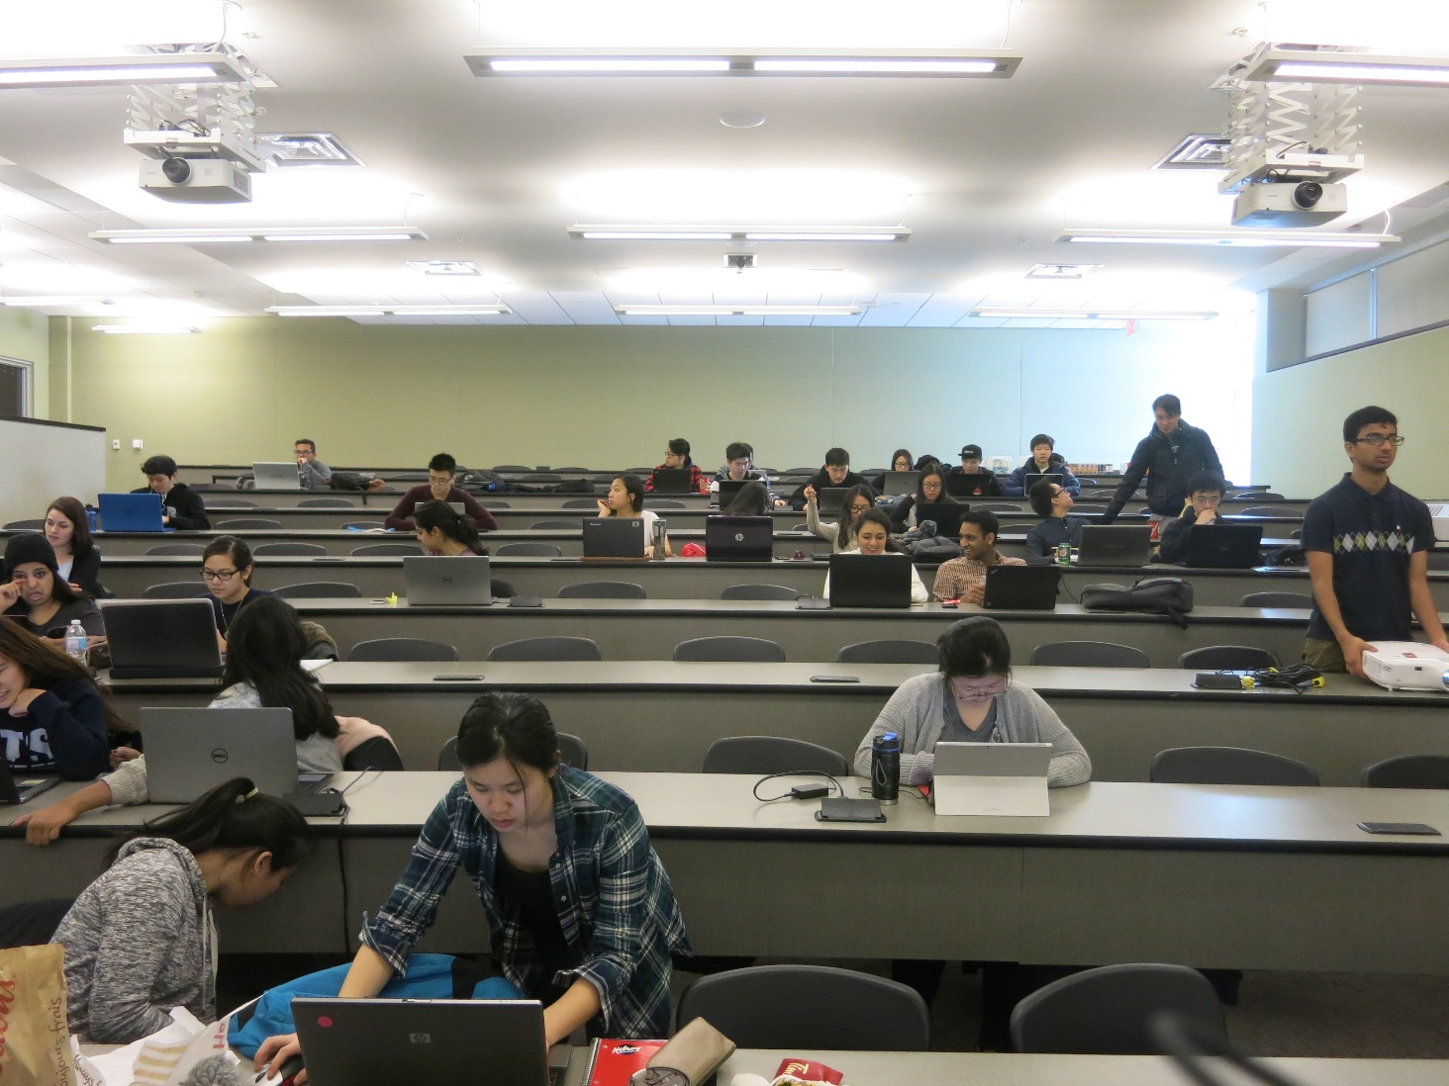
DONE.
Notes:
me@ericfong.ca

